Slide 1
Got More Questions?
Oxford Physics takes part in a wide range of community science activities. More information:
www2.physics.ox.ac.uk/about-us/outreach/public
Oxford Astrophysicists blog about research and other interesting science topics:
www2.physics.ox.ac.uk/blog/astro-blog
facebook.com/PhysicsOxford
@OxfordPhysics
Lecture Theatre
Time | What’s On
14:00 - 14:15 | Digging Deep for Dark Matter — Kathryn Boast
14:15 - 14:30 | Finding the most distant galaxy — Nathan Adams
14:30 - 14:45 | Dark Matter and His Dark Materials — Peter Hatfield
14:45 - 15:00 | Exoplanets: Terrible places to go on holiday — Belinda Nicholson
15:30 - 16:30 | ONLY CONNECT
17:00 – 17:30 | KEYNOTE: How do we know the Milky Way is a spiral galaxy? — Becky Smethurst
17:30 - 17:45 | Einstein’s relativity and black holes— Adam Ingram
17:45 – 18:00 | Mini black holes as dark matter?— John Miller
18:00 - 18:15 | Giant Galaxy Burps — Imogen Whittam
18:15 - 18:30 | New Results from the very centre of the Milky Way — Pat Roche
19:00 - 20:00 | CALL MY BLUFF
Stargazing Oxford
Activities
PLANETARIUM SHOWS
SCIENCE CAFÉ
PLANETARY SCIENCE AND EXOPLANETS
POPULAR SCIENCE LECTURES
HANDS ON - ZOONIVERSE
ASTRONOMY INSTRUMENTATION
ASTROCRAFTS
REMOTE RADIO TELESCOPE OBSERVING
EXOPLANET WEATHER FORECASTING
VIRTUAL REALITY HEADSETS
Saturday 25th January 2020
2 pm - 9 pm
Denys Wilkinson Building, Keble Road, Oxford
Last entry 8:30 pm
We are joined today by:
Abingdon Astronomical Society
www.abingdonastro.org.uk
Chipping Norton Amateur Astronomy Group
www.cnaag.com
join in science research at www.zooniverse.org

Slide 2
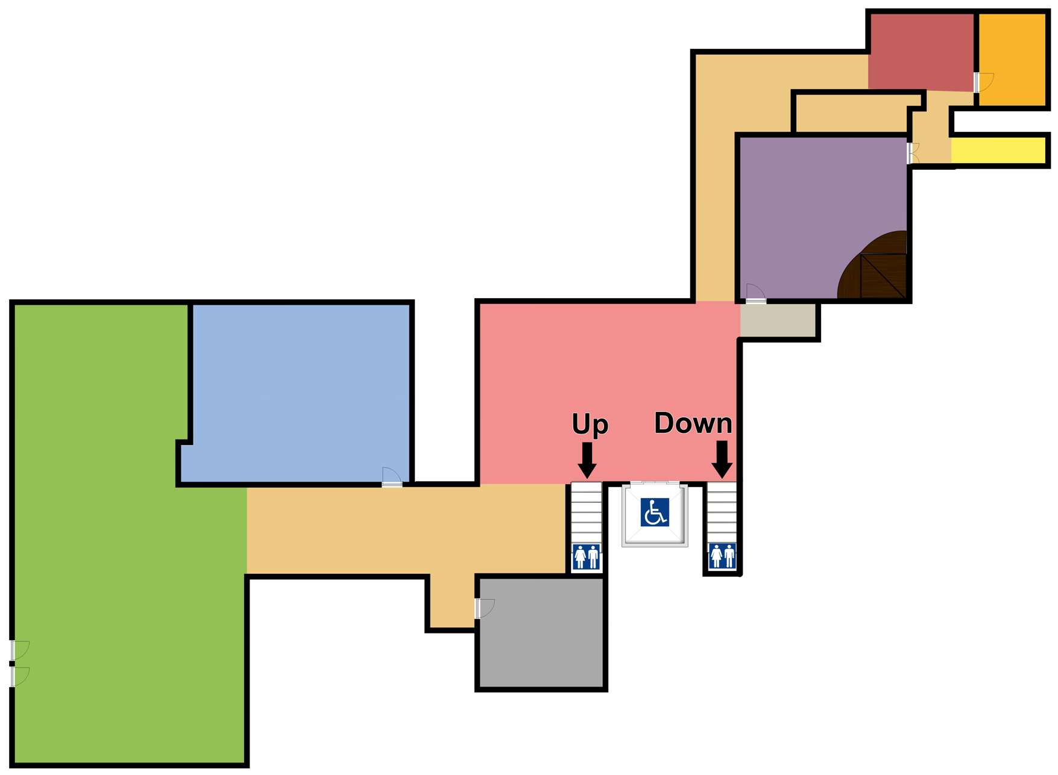
Stargazing Oxford
Welcome to your local University physics department! Give yourself a couple of hours to explore at your own pace. Science is about asking questions and seeking answers, so please ask away. In space science you are never too many questions away from the final frontier…
Hands-on science:
Help with real science research in the Zooniverse.
Zooniverse + Gravity
Amateur
Astronomy
Lecture
Theatre
Solar
Observing
(2 - 4:30 pm)
(TBC)
Presentations & games:
Schedule overleaf
Science Cafe:
Explore the latest space science research. Have a cup of tea and ask an astronomer about space!
Level 5
Exo-weather + Virtual Reality
Telescopes
and Stalls
Meeting
Point
Science Cafe
Up for…
Level 6
Telescopes and the Night Sky
Down for…
Level 4
Astronomy Instrumentation
Remote Observing
Reception and Main Entrance
Toilets
Level 3
Planetarium Shows*
Tactile Universe
Planetary
Science
Canteen
Constellation
Installation
To Astro-Crafts
*Shows run every half hour and are about 20 minutes long. Last show is at 8:00 pm.
Closes at 7:00 pm

