Slide 1


Understanding the Strong Interaction at the LHC: a Key for Finding New Physics
Pierre-Hugues Beauchemin
Tufts University
HEP Seminar, Oxford University 07/05/2013

Slide 2
Outline
Studying the strong interaction at the LHC
  Why is it an important aspect of LHC physics program?
  Why studying QCD in W/Z events at the LHC?
Various QCD studies in W/Z events at ATLAS
  Parton distribution function (PDF)
  QCD bremsstrahlung
  QCD hard parton emission (W/Z+jets)
  Heavy flavors
A look at new physics
  Apply some of the lessons learned to searches in jets+E_{T}^{miss} events
  Constraints on dark matter
Conclusions

Slide 3
Studying the strong interaction at the LHC

Slide 4
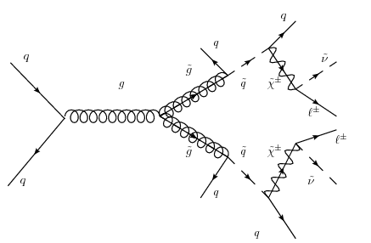
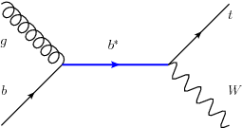
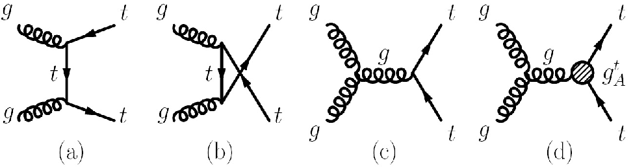
The strong interaction at the LHC (I)
Events with jets in final state are typically copiously produced via the strong interaction at hadron machines

Slide 5
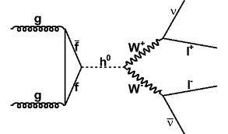
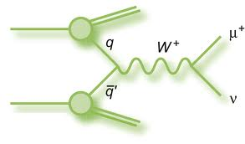
The strong interaction at the LHC (II)
New Physics or Standard Model processes with no jets in the final state also involve the strong interaction in their production
A good understanding of soft and perturbative QCD is crucial for the LHC physics program
  both for searches and measurements

Slide 6
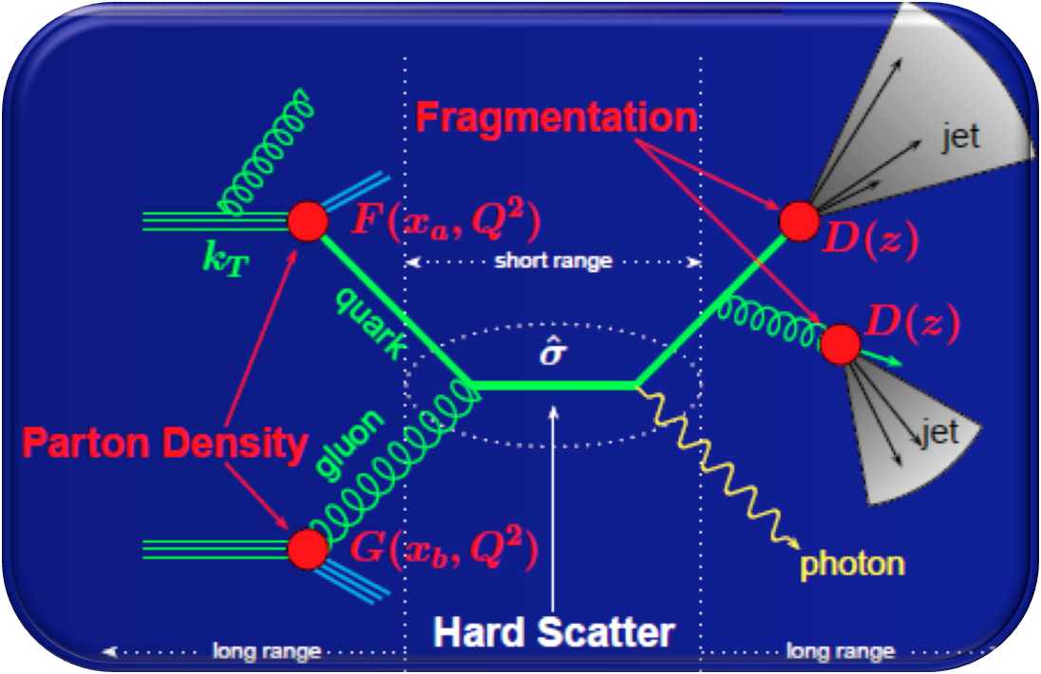
The strong interaction at the LHC (III)
The strong interaction intervene in various ways and at various scales in an event
  Hard scatter
  QCD bremsstrahlung
  Parton density function
  Fragmentation and hadronization
  Multiple interaction
Factorization theorem:
Predictions can be obtained from the convolution of short distance physics and non-perturbative effects:
Allows for robust predictions for a large spectrum of observables

Slide 7
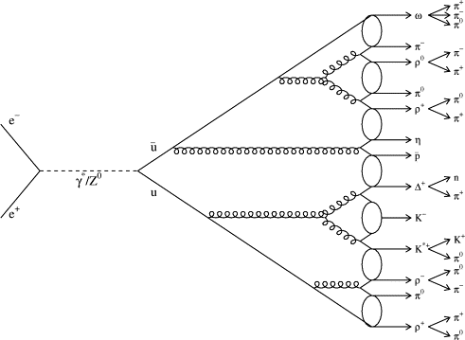
The strong interaction at the LHC (IV)
Perturbative QCD is also playing a role in relatively soft physics:
  Evolution of PDF from ≈on-shell partons to high-Q² hard process
  ➔ DGLAP equations
  Resummation of soft and collinear radiation to (Next) Leading Logs
  ➔ Parton shower (PS) interfaced to hard scattering in generators
Different level of predictions to be tested
  LO matrix element + PS+ hadronization
  Multiple parton matrix element matched to PS
    Model QCD radiation over a wide range of scales
    Various matching scheme (e.g.: MLM, CKKW)
  Full fixed order NLO calculation
    Method based on Feynman diagram+known integrals
    Method based on unitarity and on-shell recursion
  Full fixed order NLO + PS

Slide 8
Generators used and tested
Non exhaustive list
Generator | Interfaces | Comments
ALPGEN | HERWIG+ JIMMY, PHOTOS, CTEQ6L1, AUET2 tune | mP- ME up to 5 parton, MLM matching
SHERPA | CTEQ6L1, Default UE tune | mP-ME up to 5 parton, CKKW matching; also NLO
PYTHIA | PHOTOS, MRST 2007 LO | LO ME+PS+Hadronization
MCFM* | CTEQ6.6/CTEQ6L1 | NLO up to 2-jets (Feynman graph)
BLACKHAT*+SHERPA | CTEQ6.6M | NLO up to 5-jets (unitarity)
POWHEG | PYTHIA | NLO+PS (1-jet)
MC@NLO | HERWIG | NLO+PS
FEWZ* |  | NNLO
* For comparison to data, correction for hadronization and underlying
events applied to parton-level MC using ratio of Pythia events

Slide 9
Need for precision (I)
QCD predictions involve assumptions, approximations, and limitations
  Fixed order in α_{s}, soft and collinear approximation in parton emission, phenomenological model for non-perturbative effects, dependence on various arbitrary scales (μ_{R}/μ_{F}, Λ_{QCD}), etc.
Source of systematics uncertainties
From theory on experimental results
50 % of the
systematic
uncertainty
E.g.: Search for 3rd Generation Leptoquarks
E.g.: ttbar cross section

Slide 10
Need for precision (II)
It is important to optimize the precision on the theory
  Improve sensitivity to new physics
  Better precision measurements
  Better limits
E.g.: Is the excess in γγ-channel over SM Higgs expectations (μ>1) real,
instrumental or the effect of limited predictions???

Slide 11
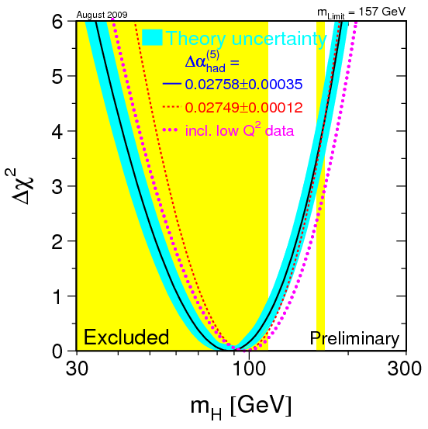
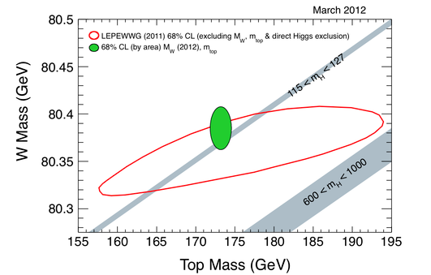
Need for precision (III)
Precision measurements can provide very useful information about new physics
For example, LEP electroweak parameters and Tevatron top-quark and W-boson masses precision measurements got the right Higgs mass!

Slide 12
Need for precision (IV)
While the Higgs-like particle discovered last Summer is not fully understood yet, its discovery wasn’t compromised by the precision of the theoretical predictions underlying the analysis
  Resonances are robust signal with very little use of theoretical modeling
A large spectrum of future measurements or of potential new physics discovery won’t benefit from such robustness
  Non-resonant new physics signal
    E.g. Dark Matter
  Coupling measurements
    E.g.: Uncertainty of ~10% on ttbar x-sect vs ~1.3% for M_{top}
  Need for precision
  Need for a better understanding of QCD

Slide 13
Studying QCD at the LHC (I)
What can we learn at the LHC that we haven’t learned at the Tevatron?
  Higher center of mass energy
    Higher jet P_{T} reach
    More parton radiation
    Higher jet multiplicity
    Different PDF regime
  Involve different type of parton
    Different mixture of final state quark and gluons
    Different colliding partons (pp vs ppbar)
    Processes with heavy flavor in initial state
  New experiments
    Larger acceptance (eg: forward jets)
    More statistics
    Better precision to test higher order effects
Also true
for coming
14 TeV
LHC runs
From J. Campbell
~30% @ LHC vs
~10% @ Tevatron
➔ Good complementarity

Slide 14
Studying QCD at the LHC (II)
Particularly interesting to probe QCD with events involving vector bosons?
  W and Z are very well understood (lepton efficiencies, backgrounds, etc.)
    Very powerful for jet calibration and study of other detector effects
  Look at quark jets rather than gluon jets, at least for the leading jets.
    Study quark radiation
  Abundantly produced and easy to trigger on with lepton trigger
    Can go to low jet p_{T} threshold
Complementary between inclusive and exclusive jet observables
  Inclusive to study PDF
  W/Z P_{T} sensitive to soft/collinear QCD radiation;
  W/Z+jets sensitive to hard QCD radiation and heavy flavor
Important backgrounds to numerous new physics signatures
Will concentrate on pQCD studies!

Slide 15
W/Z+Heavy flavor at the LHC
Heavy flavor content of the PDF
Poorly constrained theoretically
  Test various flavor schemes and calculation approach
    Fixed vs variable flavor scheme
      Quark only in final state or also in initial state
    massless vs massive
  Tension between theory and CDF results
  D0 results don’t see this tension
    1.05 ± 0.12 (data) vs 1.34 ± 0.41 (NLO)
Important background to Higgs
discovery, BSM searches, and
precision measurement of top physics
VS

Slide 16
Results: Various QCD studies in W/Z events at ATLAS

Slide 17
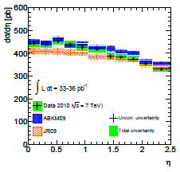
PDF: W/Z inclusive (I)
Phys. Rev. D85 (2012) 072004
Physics motivation:
  Reference cross section
  PDF fitting
  Lepton momentum calibration and reconstruction efficiency
Measurement results:
  Reached a precision of 1.25% (σ(W,Z))
  Measured dσ/dη

Slide 18
PDF: W/Z inclusive (II)
Highly precise measurements of the ratio of W to Z cross sections allow for a test of Lepton Universality
Results already comparable to PDG value for the case of W!

Slide 19
PDF: W charge asymmetry
Phys. Lett. B701 (2011) 31-49
Different W+ and W- production provides more information about proton structure
  W produced mostly via valence quark interaction
  |y|-dependence sensitive to differences between u and d Parton Distribution Functions
  Difficult to reconstruct W-boson rapidity: use decay lepton pseudorapidity
Measurement compares well with predictions
  No clear “best PDF”
Common phase space agreed
between ATLAS, CMS and LHC
in LHC EWK working group

Slide 20
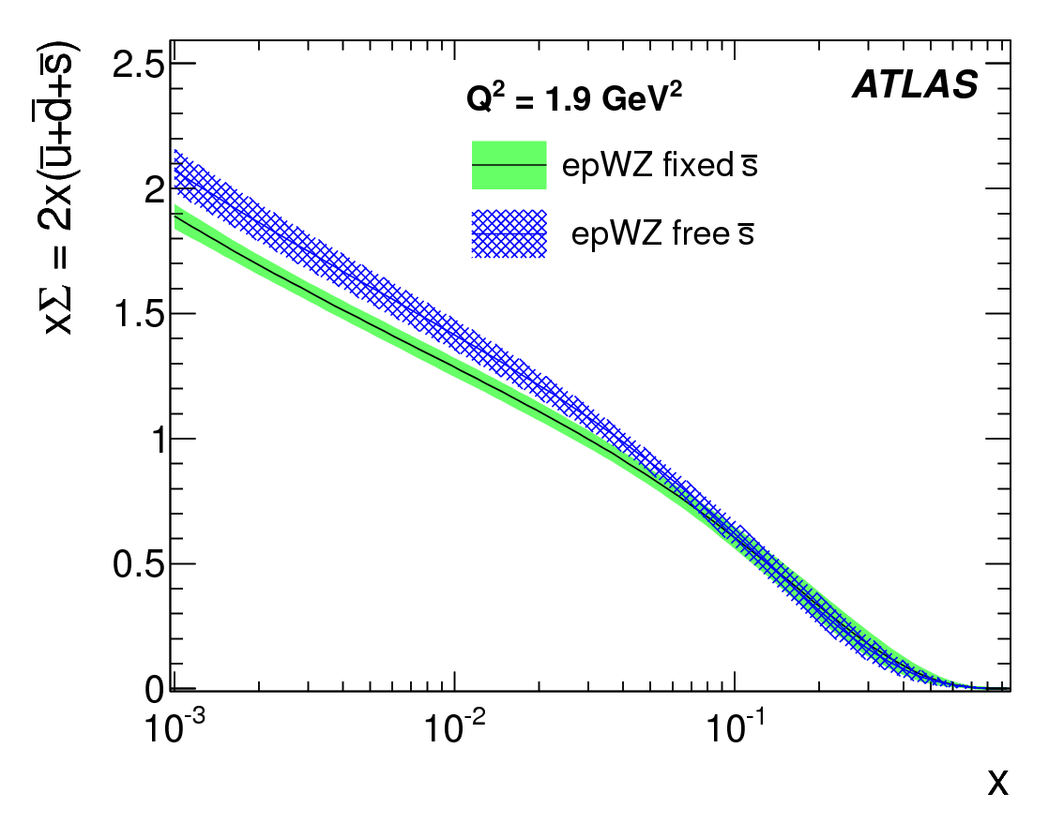
Impact on the PDF
W/Z results included in NNPDF2.2
  Impact the precision of quark density at low x
Also introduce a novel sensitivity to s-quark density at x~0.01
  Ratio of s- to d- sea quarks density is r_{s} = 1.0 ± 0.3
  Light sea quarks a low x are consistent with being flavor symmetric
  Total sea quark density enhanced by 8%

Slide 21
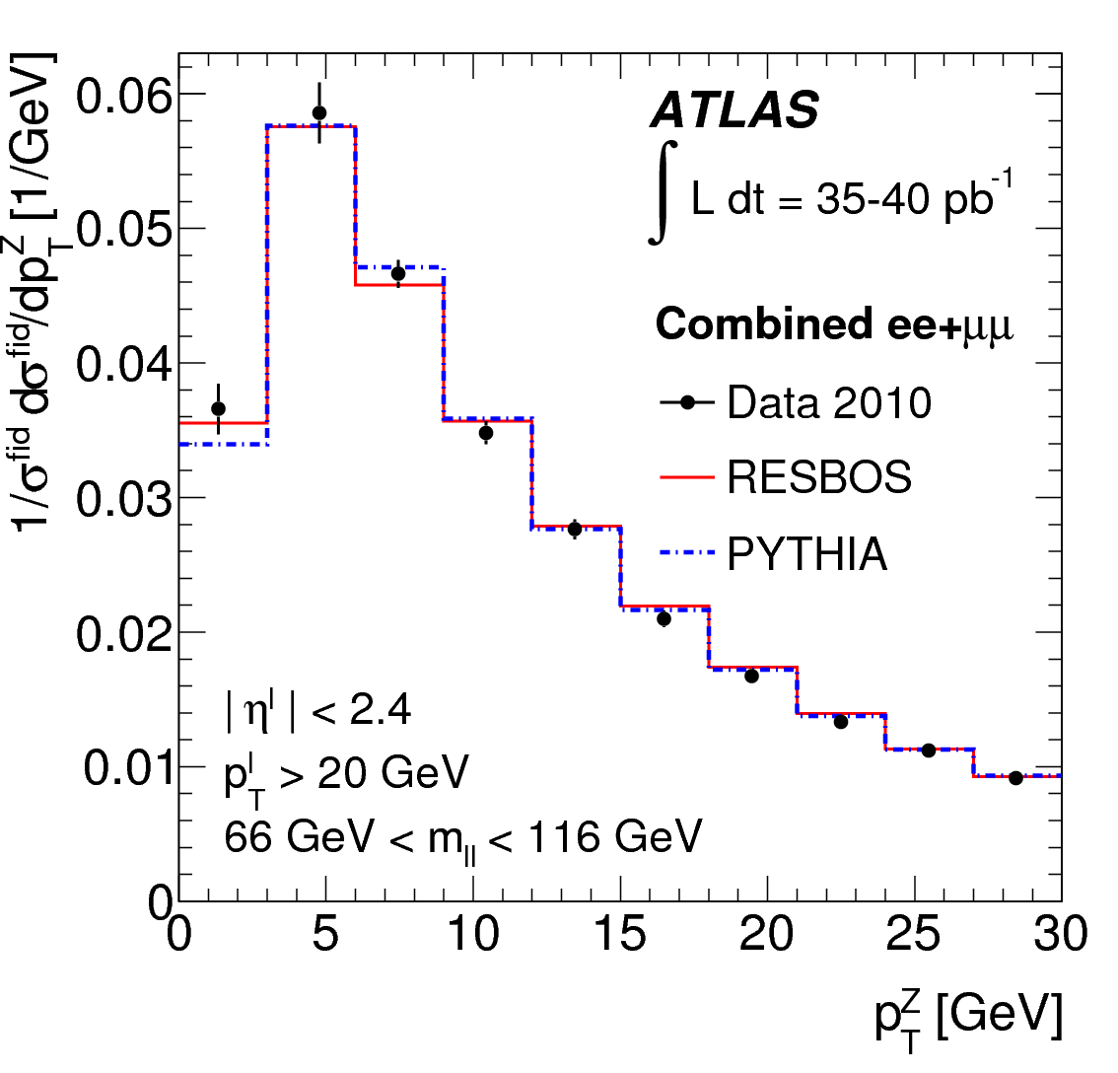
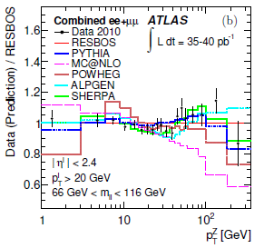
QCD bremsstrahlung:
Vector Boson P_{T}
Phys. Lett. B705 (2011) 415-434
Test multiple aspect of QCD predictions
  Intrinsic-K_{T}
  Low-PT (W,Z): logarithmic resummations
    RESBOS provides a NNLL resummation
  High-PT (W,Z): (N)NLO perturbative QCD
  Important test of parton shower tuning
    No color flow between initial and final state
Measurements results:
  Reach high precision (most significant bins)
    Z: 1.5% to 3.7%
    W: 2.4% to 5.0%
  Best description from high parton multiplicity
  matrix element matched to parton shower
  Much better description from NNLO calculation (FEWZ) than NLO, but not comparable to PS or NNLL resummation matched to ME

Slide 22
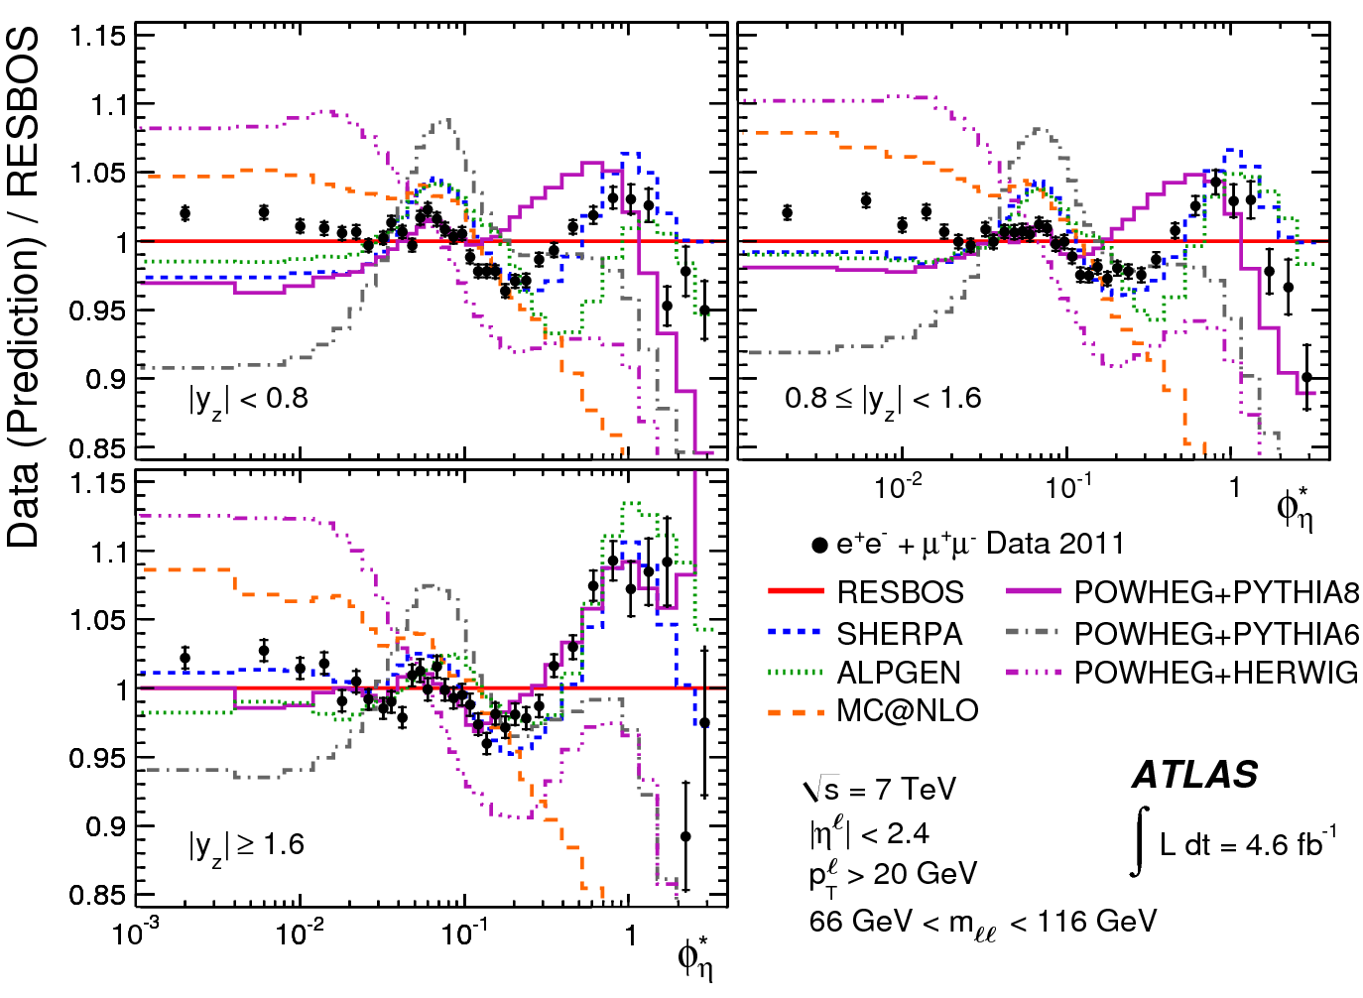
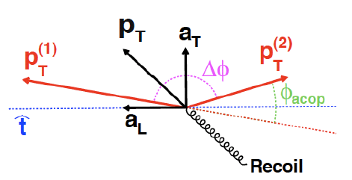
QCD bremsstrahlung:
Vector Boson φ*
Phys. Lett. B720 (2013) 32-51
Complementary physics can be obtained by measuring Z φ*
  Finer resolution (bin) at low P_{T}^{Z}
  Smaller systematic
    From 0.1% to 0.6%
    2% to 6% for theory
Best agreement:
  NNLL at low value
  PS matched to multiple
  parton ME at high value
  Sensitivity to PS tuning
Depend solely on angle of two leptons
Highly correlated to P_{T}^{Z}/M_{ll}
  0< φ* < 1 ⬄ P_{T}^{Z} < 100 GeV

Slide 23
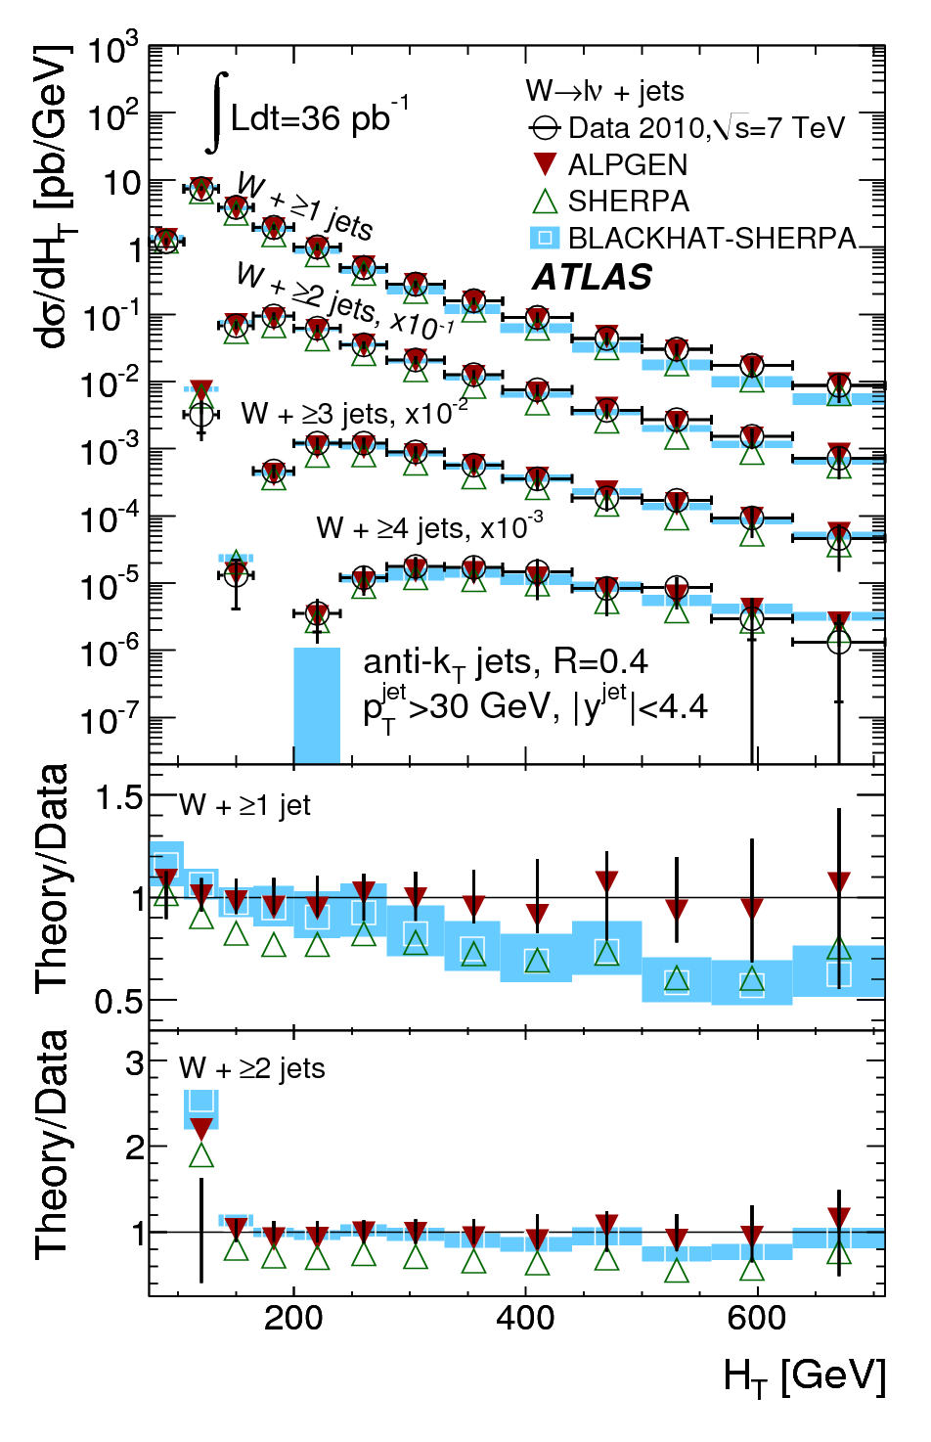
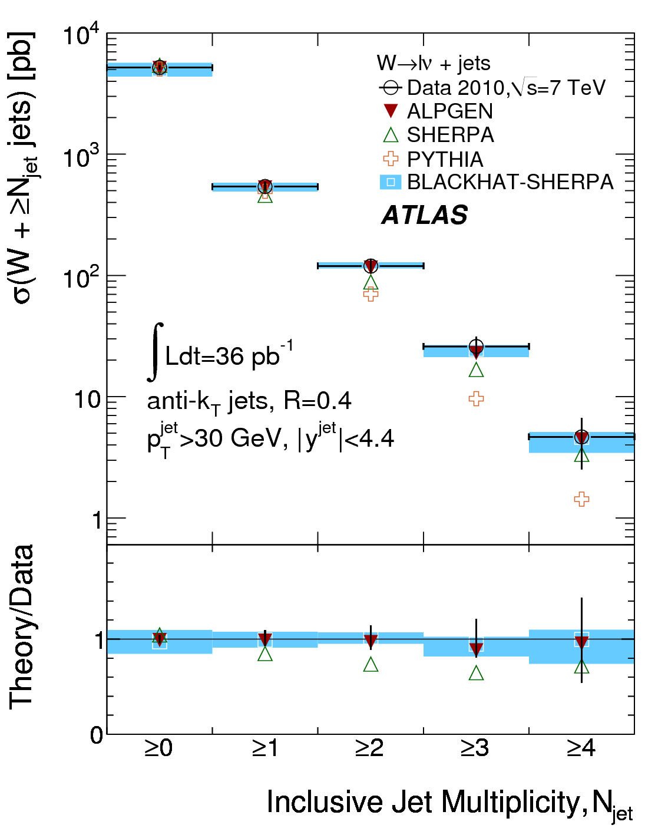
Hard radiation: W+jets
Phys. Rev. D85 (2012) 092002
Test pQCD in more exclusive final states
  Probe hard QCD radiation from matrix element
  Less sensitive to soft radiation and fragmentation
  Direct study of SM in regions where new physics is expected
  Study potentially large scale dependence (e.g. H_{T})
Multiplicities in good agreement with NLO
  lack of high-energy large-angle emissions in PS MC (Pythia)
  Better modeling of total jet energy in Alpgen
  Good agreement with NLO up to 4 jets

Slide 24
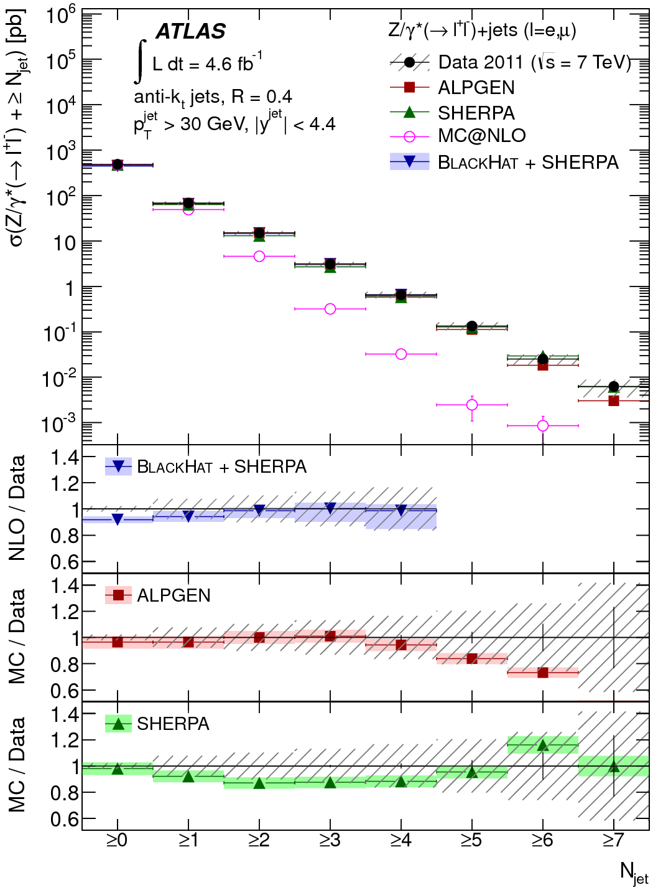
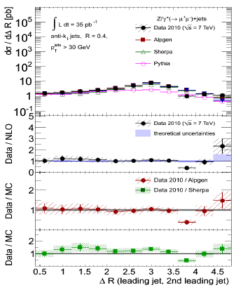
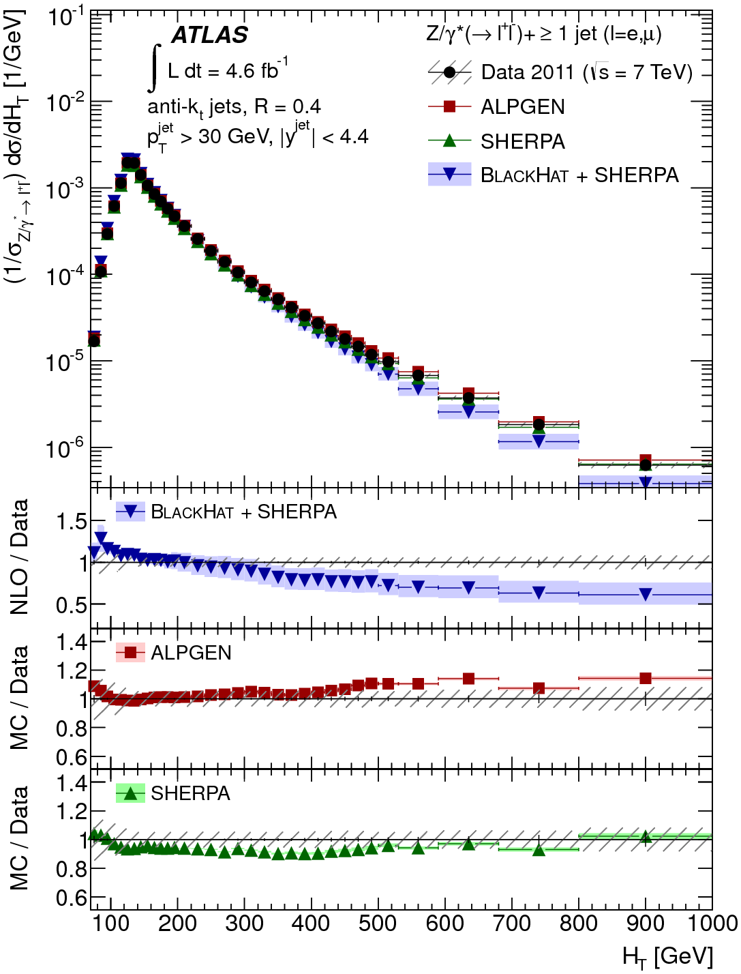
Hard radiation: Z+jets (I)
Phys. Rev. D85 (2012) 032009
arXiv:1304.7098
Similar conclusions as in W+jets measurements
  NLO and mP-ME+PS describe data up to 4/5 jets
  PS jets are too soft or at low angle
    Not an effect of missing NLO corrections on ME
  Some observables need higher multiplicity fixed order calculation

Slide 25
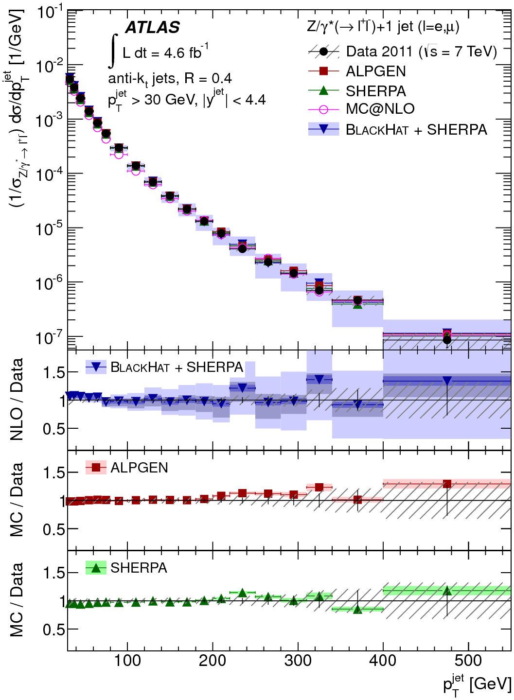
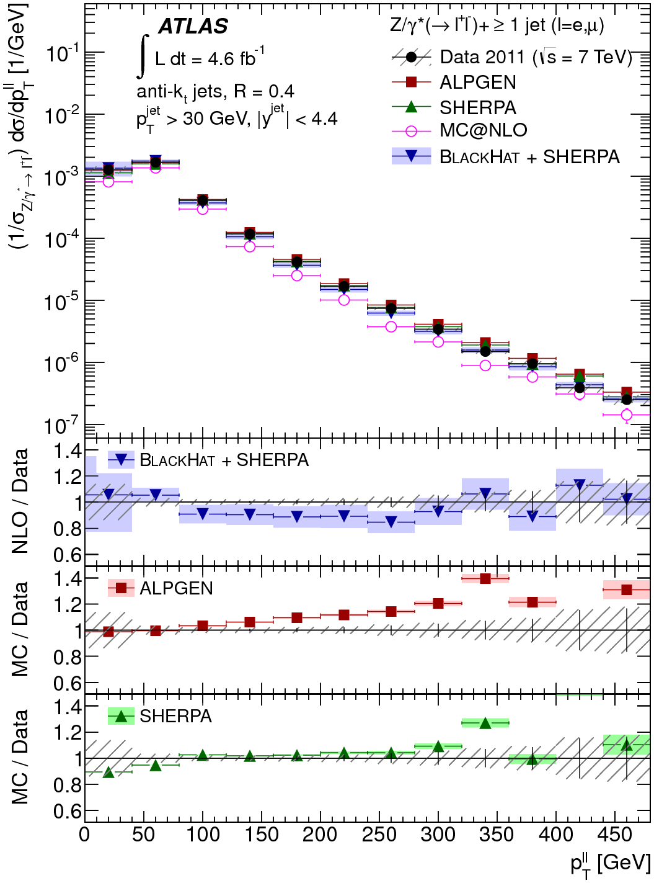
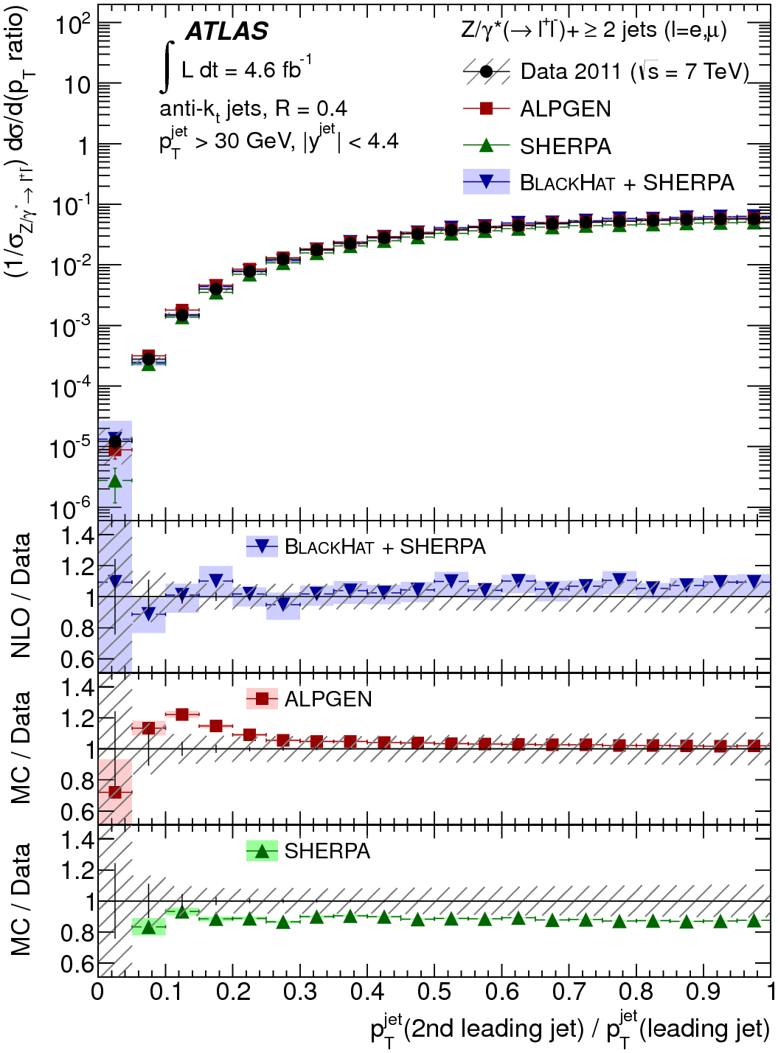
Hard radiation: Z+jets (II)
Interesting effects appears at very high PT
  Large k-factors
  higher order QCD and EWK corrections become important
  Higher multiplicity from hard radiation are important
  Test of matching

Slide 26
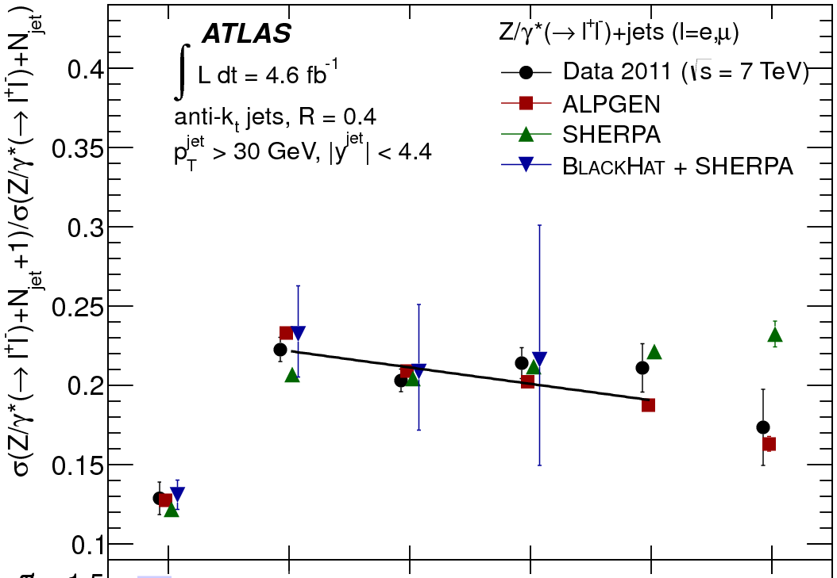
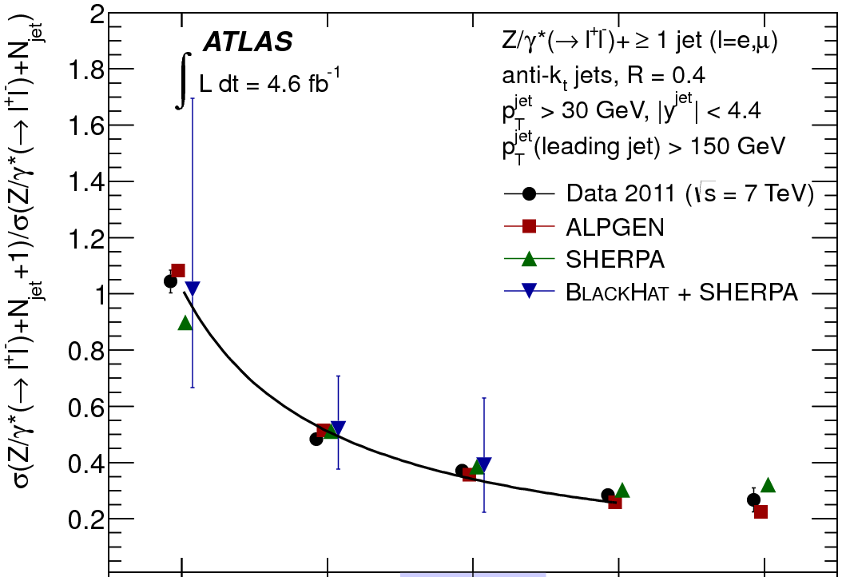
Hard radiation: scaling patterns in Z+jets
Study the probability that an extra hard jet get radiated from a given hard process: R_{(n+1)/n} = P_{n+1}/P_{n}
Two patterns provide limiting cases for most LHC processes
  Staircase scaling R_{(n+1)/n} = e^{-b}: non-abelian QCD effects
    Radiation depend on the hard process due to PDF
  Poisson scaling : gluon radiation off hard quark
    Log enhanced radiation ME due to large hierarchy of scales
Theorically
Understood!
P_{T}^{jet} > 30 GeV
P_{T}^{jet} > 30 GeV
P_{T}^{lead} > 150 GeV
1/0
2/1
3/2
4/3
5/4
6/5
2/1
3/2
4/3
5/4
6/5

Slide 27
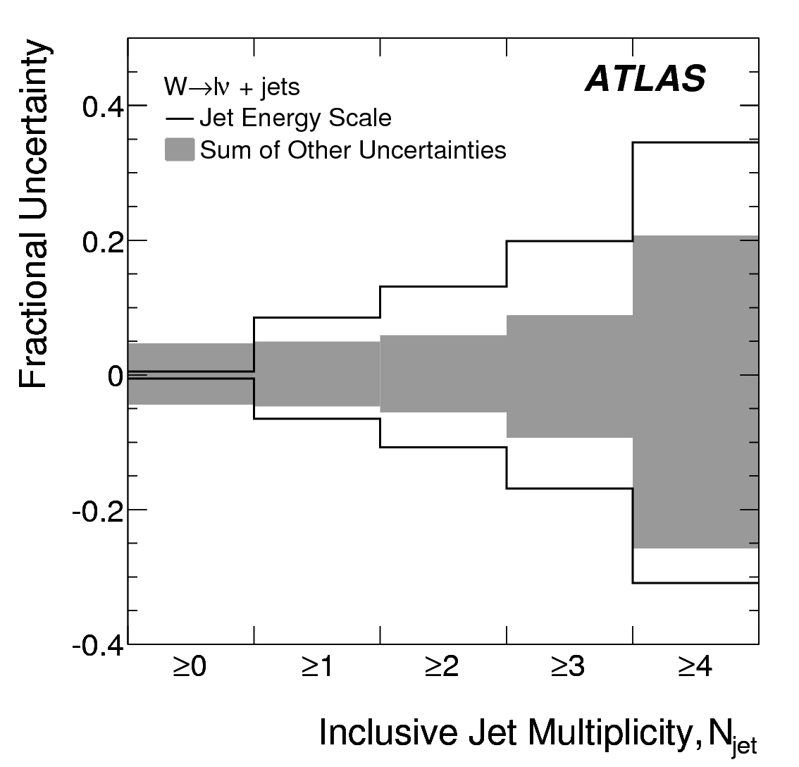
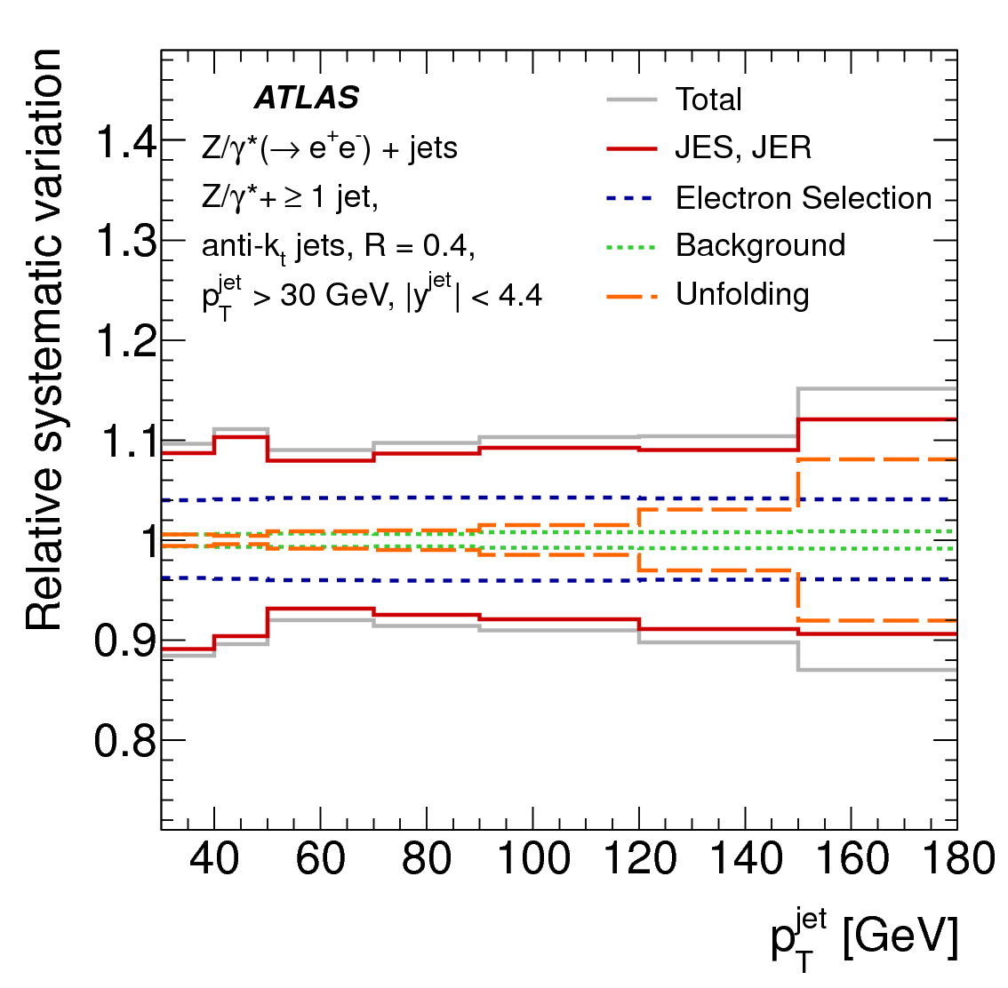
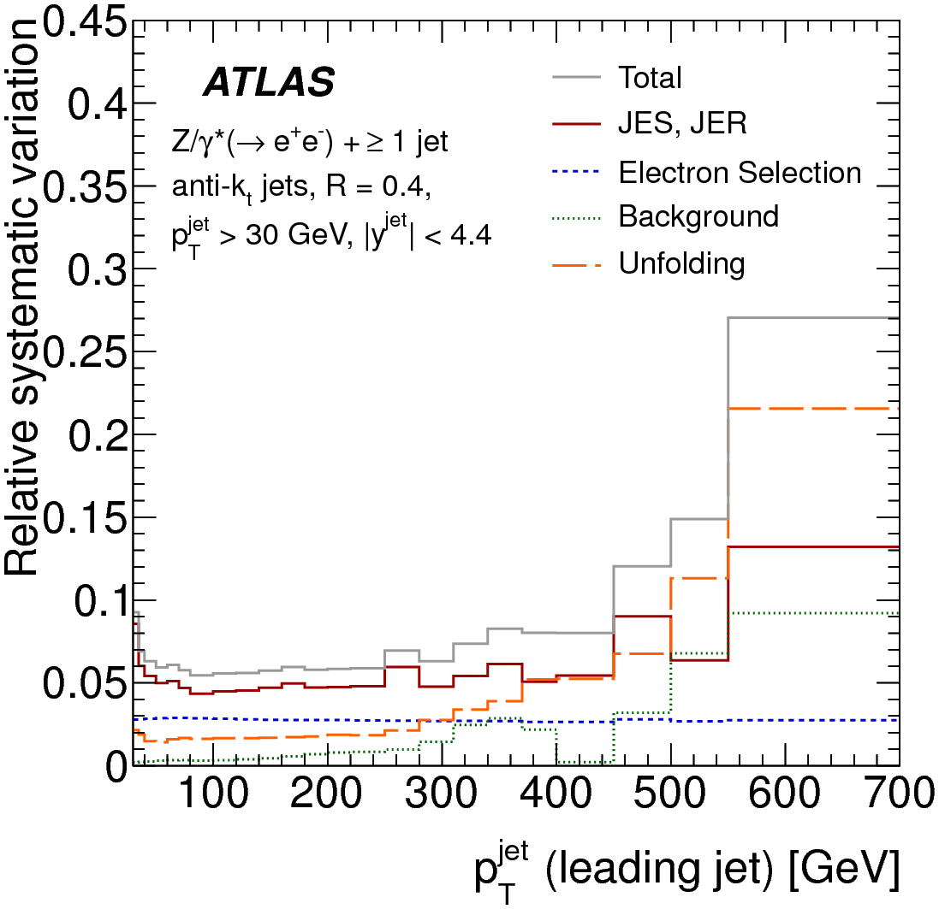
Systematic uncertainties (I)
Systematic uncertainty at same level as the NLO theory uncertainty for W/Z+jets measurements
  Even below for some observables
    E.g.: leading jet P_{T} in Z+jets
  Dominated by Jet energy scale uncertainty
    More data allow for in-situ calibration studies
  Statistical uncertainty important in a large part of the spectrum probed
W+jets (2010 data)
Z+jets (2010 data)
Z+jets (2011 data)

Slide 28
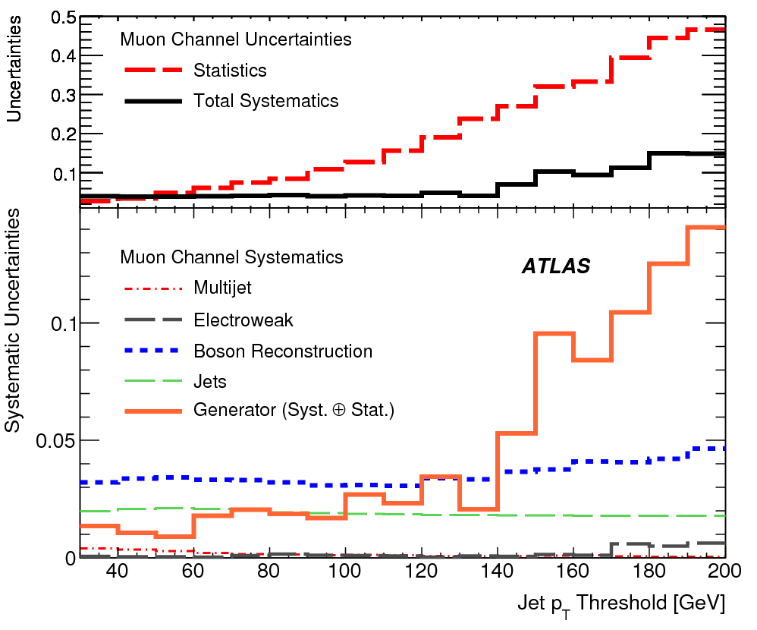
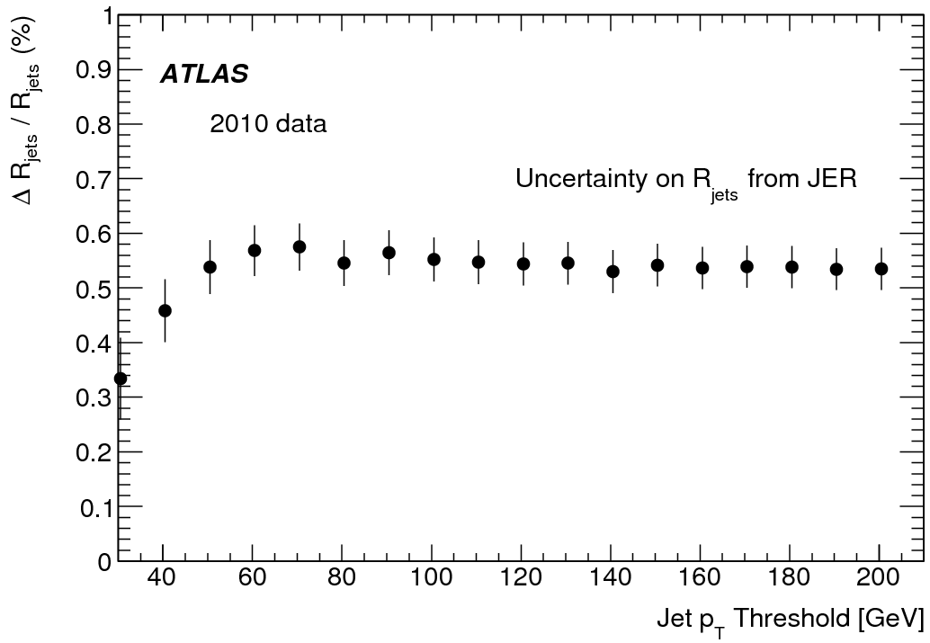
Systematic uncertainties (II)
Systematic substantially reduced in the case of ratios
  Rjets dominated by lepton rather than jet systematics and prediction almost insensitive to PDF uncertainties
  ➔ A precision observable
Level of cancellation of
Jet effects in Rjets

Slide 29
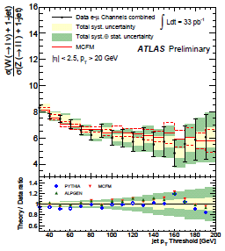
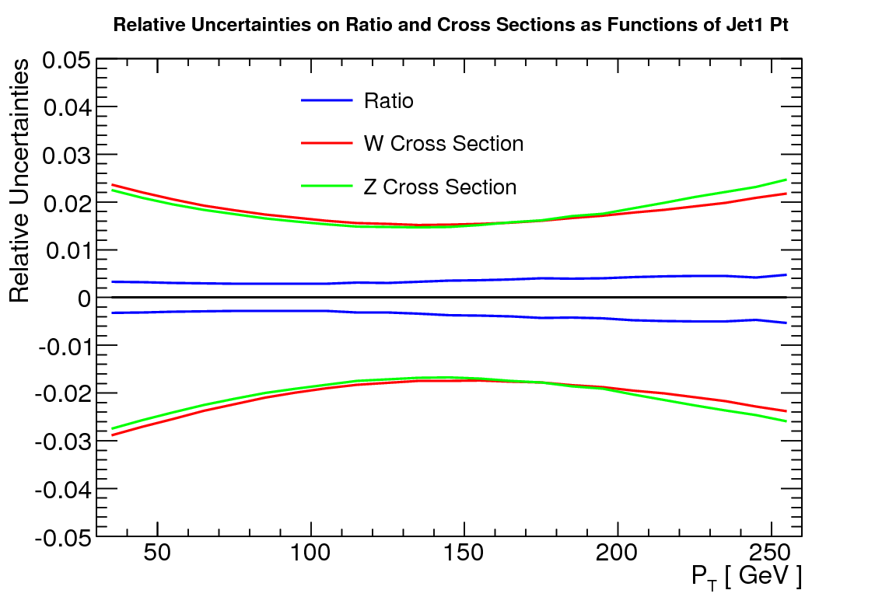
Hard Radiation: Rjets
Phys. Lett. B708 (2012) 221-240
The ratio of W+jets to Z+jets cross section retains some sensitivity to higher order hard emission effects on some observable, and very little dependence on some others
  high precision and very little dependence on non-perturbative effects (PDF, fragmentation, underlying events)
  Powerful observables for new physics
  Exclusive jet selection enhance impact
  of hard radiation for QCD studies
Δσ _{PDF}

Slide 30
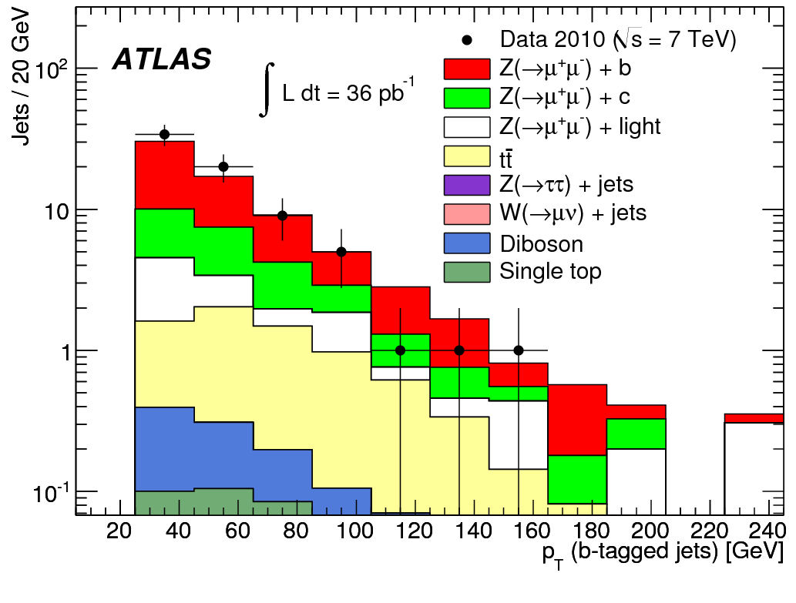
Heavy flavor: Z+b-jets
Phys.Lett. B706 (2012) 295-313
Good agreement with NLO MCFM and SHERPA, but 1.2σ deviation with ALPGEN
  Seems to favor scheme where b-quark is taken from PDF
  Doesn’t favor massless over massive scheme
Good description of b-jet p_{T} shape
  Not yet a differential measurement

Slide 31
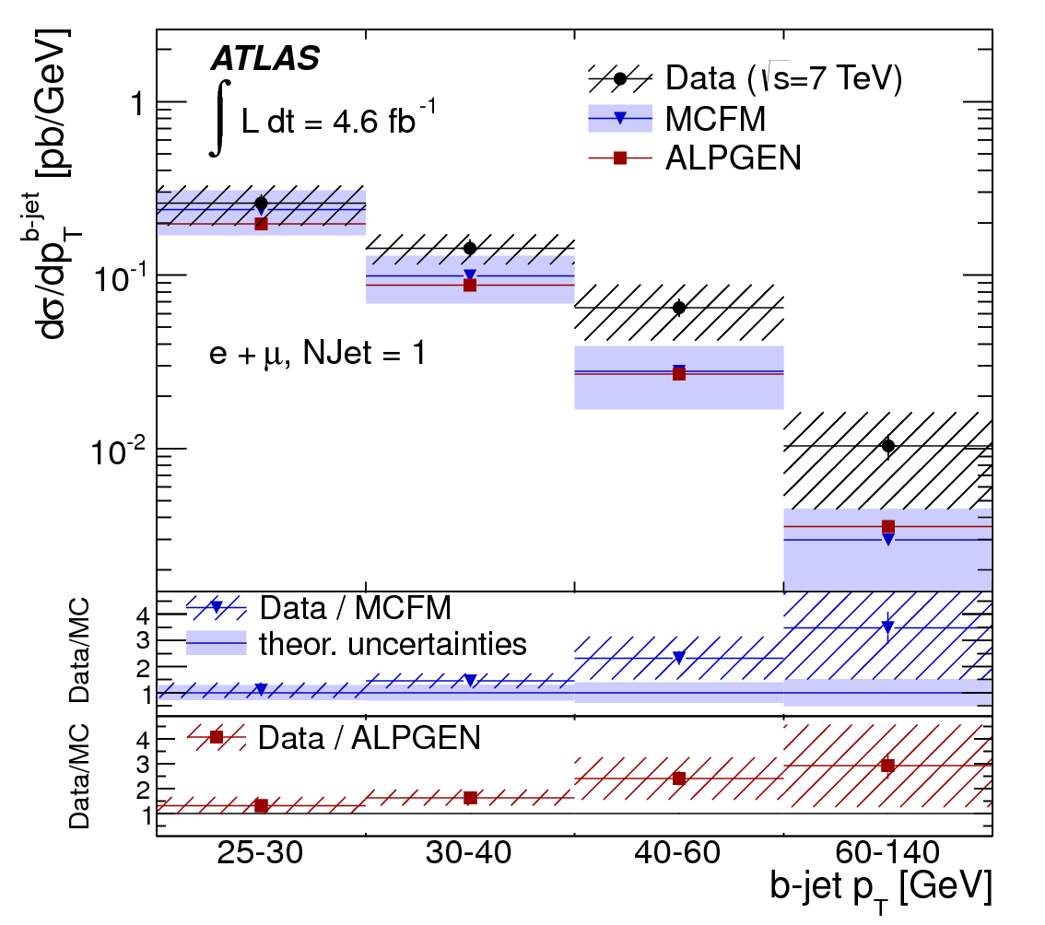
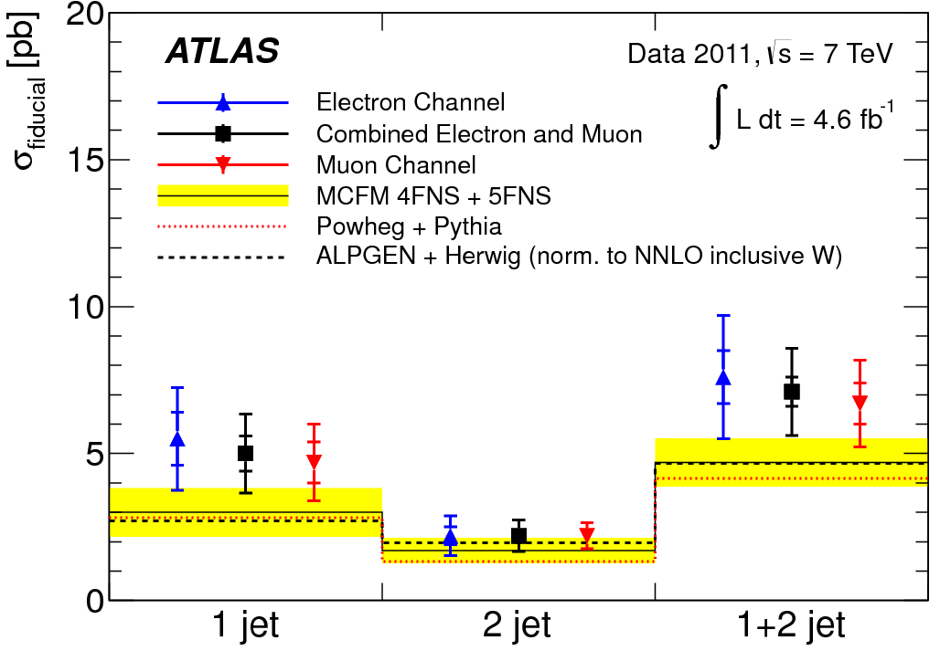
Heavy Flavor: W+b-jets
Phys.Lett. B707 (2012) 418-437
arXiv:1302.2929
While Z+b-jets cross section measurement agrees well with NLO predictions, a small tensions is again observed between W+b-jets measurements and theory predictions
  Larger in the 1-jet bin than 2-jets
    Only a ~1 sigma deviation
  Systematically increasing with P_{T}
  ➔ Not yet significant
  ➔ Need more precision t0 conclude…

Slide 32
A look at New Physics

Slide 33
A Problematic situation…
Summary of our discussion so far:
  We need to get more precise QCD predictions
  ATLAS W/Z physics measurements reached sufficient precision for testing state-of-the-art QCD calculations
  … but can’t exactly tell yet what needs to be improved and how:
Theory and experiment are mutually adjusting processes that take time
New physics searches are taking place in parallel with QCD studies, but at a faster pace
  Many analyses can live for a while with larger systematics as they are anyway highly statistically limited
  Some analysis simply keep lower sensitivity until calculations improvements get available

Slide 34
… and a solution
But some analyses can use one of the important lesson learned:
RATIOS suffers from much smaller experimental and QCD theory uncertainties and can thus be used to optimize the precision of background estimate in new physics searches
This is what makes data-driven background estimate techniques so powerfull!
Jets+E_{T}^{miss} final states a priori suffers from very large systematic uncertainties
  We will show that surprisingly good precision can be obtained when profiting from ratios to get jets+E_{T}^{miss} data-driven background estimate
    We will concentrate on low jet multiplicity final state (“monojet”)
  This will allow us to get tight constraints on dark matter candidates

Slide 35
New Physics in monojet events
Many new physics scenario predicts high production rate for such final state:
  Generic dark matter produced via contact interaction
  Invisible Higgs
  Gauge-mediated SUSY breaking scenario: Gravitino+squark/gluino production
    Assume
  Production of graviton Kaluza-Klein mode in large extra dimension scenarios
  Unparticle
    Equivalent to LED+SUSY in the bulk

Slide 36
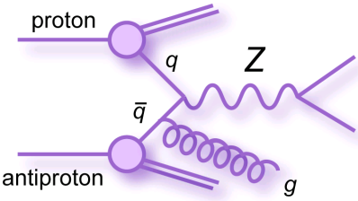
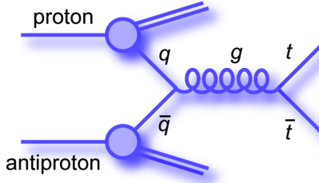
Contribution from Standard Model
Irreducible background
  Physics processes with same final state
Zνν+jets
Reducible background
  Physics processes with different final states modified by detector effects
Wlν+jets
QCD multijet
Non-collision events
Others…
  Dibosons (WW,WZ,ZZ)
  Top (ttbar, single top)
q
q

Slide 37
Data-driven background estimate 101
To produce a data-driven predictions, we can:
  1- Reverse one (few) signal selection(s)
    Avoid signal contamination
Set of selections defining
signal (eg: monojet)
All events from a dataset
Event cut 1
Event cut 2
…
Event cut N-1
Event cut N
Y:
All other
selections
Data model
of the signal
Signal
events
Selections
to reverse
Y
X:
Z ⊆ ¬X
X
  2- Count the number of events in the Y∧Z (Z ⊆ ¬X) sample
  3- Use ratios to compute mapping factors for the final prediction
If X is unbiased with respect to Y,
then Y∧Z provides a good model for Y∧X

Slide 38
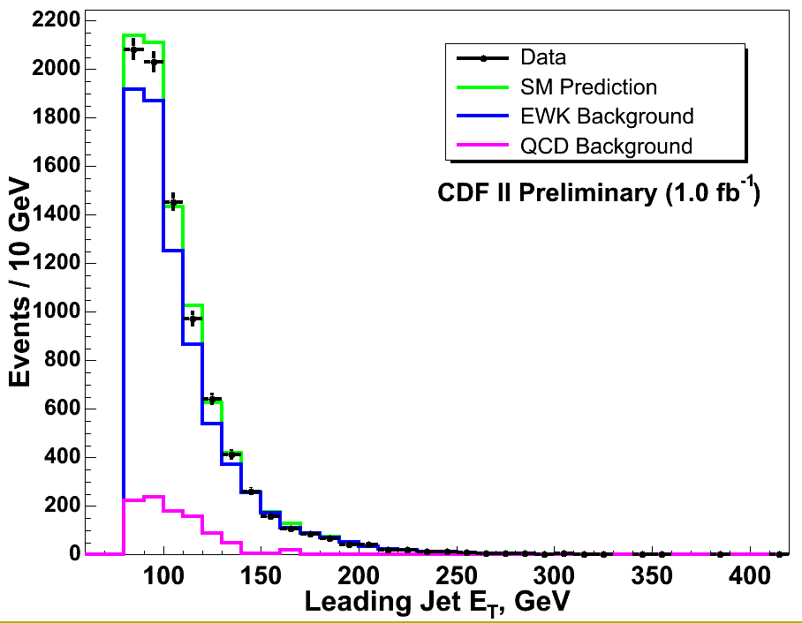
Electroweak background estimate (I)
Jets observables present similar distributions
Z→νν + 1-jet
e
Z→ee + 1-jet
Met
e
Must now use ratio to normalize and correct for shape distortion
E_{T}^{miss} can similarly
be obtained after
removing the two charged leptons
with corrections

Slide 39
Electroweak background estimate (II)
Data-driven prediction for Z→νν+jets background is obtained from:
  Number of Z→ll+jets events in each control region’s E_{T}^{miss} bin (N^{i}_{cand,CR})
  Ratio of signal region to control region observable distribution
The ratio mapping factor accounts for lepton
  acceptance and efficiency
  different cross section and branching ratios
  distortion of the measured observable due to the charged lepton in the CR
Similar exercise can be done to estimate the reducible W+jets background
  Direct use of the R_{jets} measurement
  The ratio is also corrected for the probability that the event survive the veto
  W+jets control region events are also used to estimate Zνν+jets

Slide 40
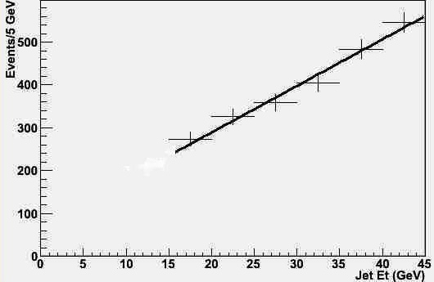
QCD multijets background estimate
Sources of QCD contribution:
  2-jets and 3-jets events for which one of the jets is lost (dominate)
  ≥3-jets events for which two jets are lost (smaller) → obtained
  from MC
To estimate the 2-jets contribution:
1- Select 2/3-jets events with
E_{T}^{miss} vector toward one jet
2- Extrapolate this jet E_{T} below energy threshold (loose a jet)
3- Background prediction
=
area under the fit in the
extrapolated region
× MC correction
2-jets events
_{Extrapolated}
_{region}
* Jet threshold lowered to 15 GeV to verify the extrapolation

Slide 41
Various signal regions
We don’t know the kinematic region in which new physics will get revealed
  Expectations vary with models
Model-independence: don’t select the kinematic region based on the indications of a particular model
➔ Or do a kinematic scan
Lowest kinematic region determined by trigger requirement
  Statistics is a limitation for data-driven estimate in high kinematic regions
E_{T}
500
350
220
120
0
120
220
350
500
Jet 1 E_{T}
41

Slide 42
Background systematics uncertainties
When taking all effects and all background into account:
  For the high stats “low” kinematic region
QCD prediction uncertainty is not the dominant background and is kept at a low level
  This estimate is a very conservative, essentially only reflecting the small statistics of the sample used to get the estimate.
  Recent studies suggest a factor of 3 to 5 smaller uncertainty on QCD effects

Slide 43
The Results (I)
JHEP 04 (2013) 075
From 5 fb⁻¹ of 2011 ATLAS data
Outstanding precision of
<4% on SM prediction
Tight constrains on
New physics models
Results are consistent with SM regardless
of the jet P_{T} and E_{T}^{miss} selections
⇒

Slide 44
Results (II)

Slide 45
The Results (III)

Slide 46
Results (IV)
Preliminary studies with 10 fb⁻¹ of 2012 8 TeV data yields very similar results than the 7 TeV 2011 results.

Slide 47
Dark Matter models considered (I)
Monojet analysis can be used to constrain dark matter production in a model-independent way
  Effective theory with contact interaction
Assumes:
  WIMPs of mass between a few GeV to few TeV range
    Detectable at the LHC
  Pair of WIMP produced from parton-parton interaction
    Heavy mediator between SM and dark sector
  Dark Matter field represented as Dirac Fermion
    Some interaction terms are disallowed
    Cross section bigger than Majorana by x4
    Can express t-channels as a sum of s-channels dirac terms

Slide 48
Dark Matter models considered (II)
Examples of operators considered
  Chosen because they correspond to different E_{T}^{miss} shapes and so generate potentially different limits
2 parameters: M* and M_{χ}
  M* = M/sqrt(g₁g₂)
    g₁, g₂ = couplings of the mediator of mass M between WIMP and SM
  Coupling flavor universal with 4 lighter quark flavors

Slide 49
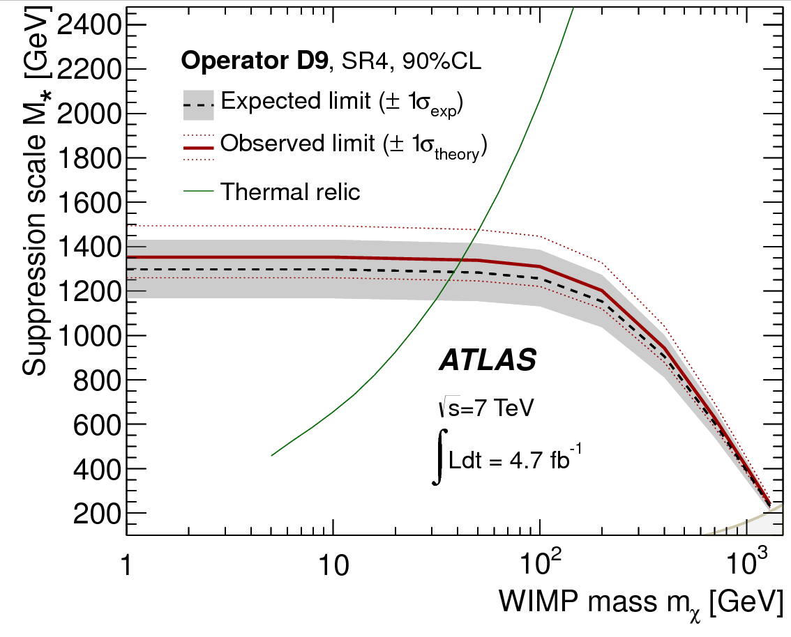
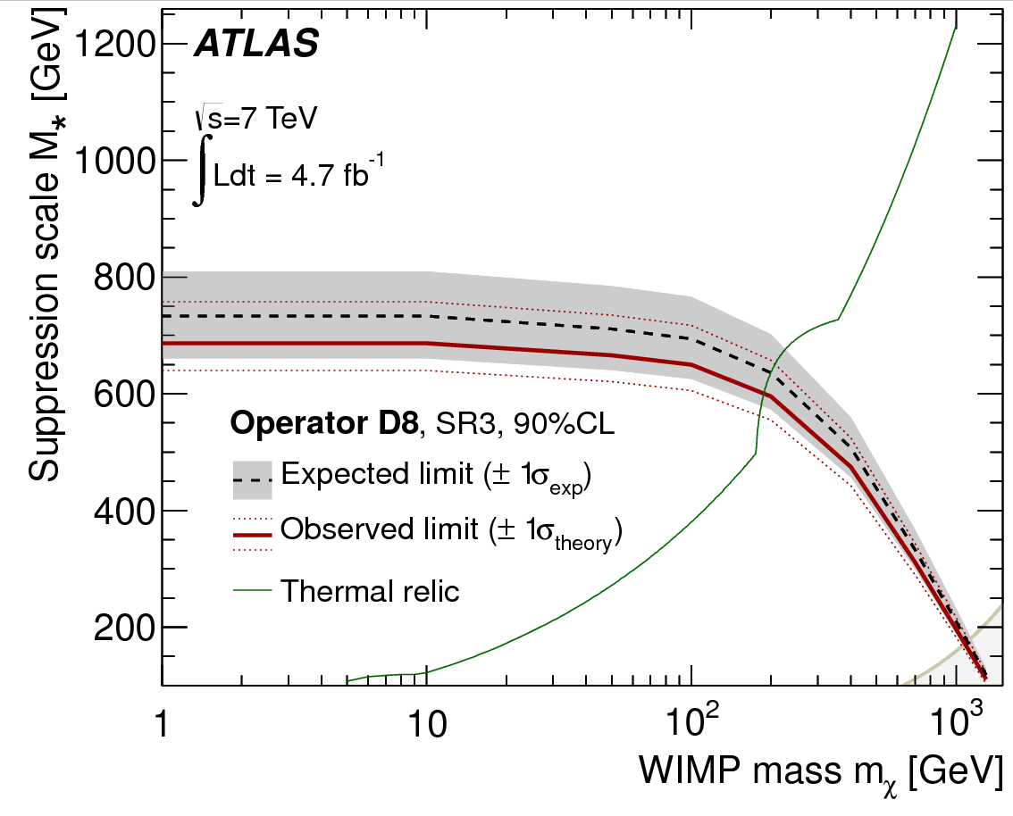
Limits
Thermal relic density observed by WMAP (green curve) is compatible with DM having couplings and mass comparable to weak scale masses and force
If M* above relic line, other annihilation processes are required for consistency to WMAP

Slide 50
More limits
Bounds on M∗ for a given m_{χ} can be converted to bounds on WIMP-nucleon scattering cross sections
  Compare to direct DM experiments
  Compare to indirect DM searches
    Use DM pair production from 4-flavors
    quark-anti-quark annihilation and
    translate it to a DM annihilation in
    bb-pair
    Compare to galactic high energy
    gamma ray observations by Fermi LAT
      γs from q-jet fragmentation

Slide 51
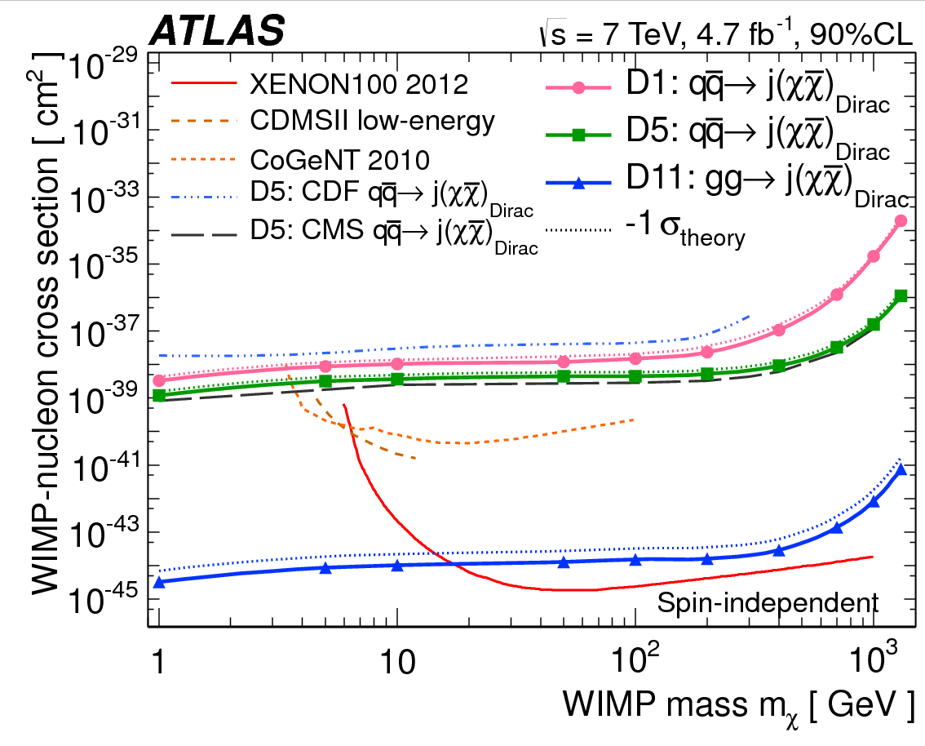
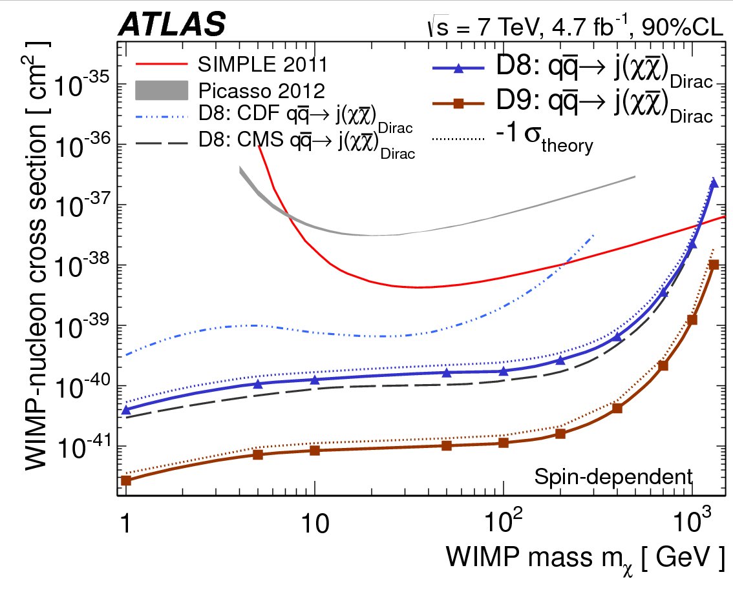
Comparison to direct DM searches
Best spin independent
Limits for m_{χ} < 10 GeV
Best spin dependent limits for m_{χ} < 1 TeV

Slide 52
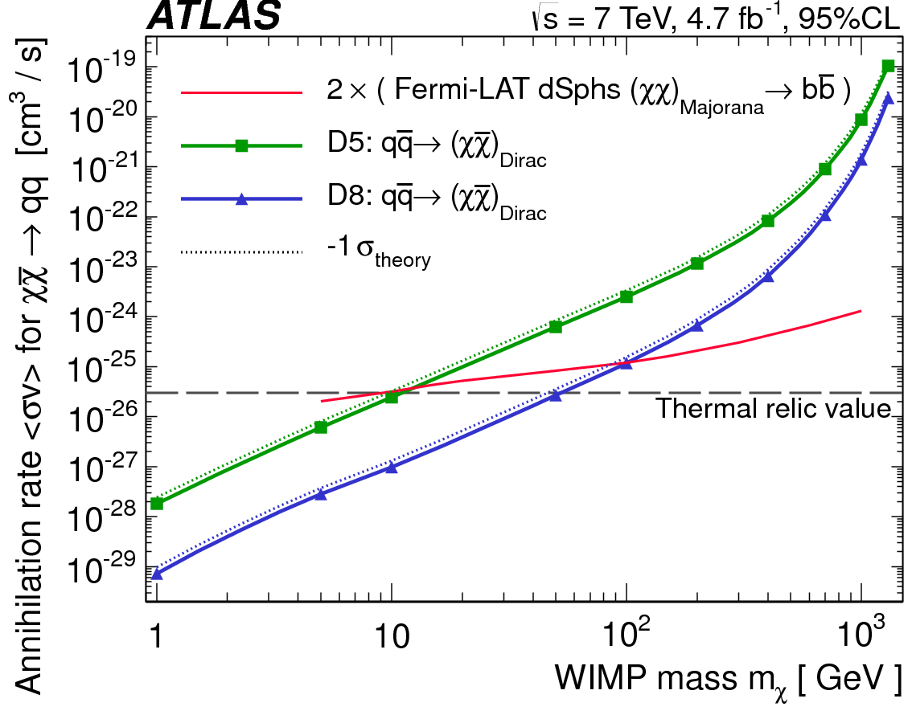
Comparison to indirect DM searches
LHC and Fermi LAT are complementary, LHC having better constraints below ~100 GeV

Slide 53
Conclusions

Slide 54
Conclusion
Sensitivity to new physics and parameter values require precise QCD predictions
7 TeV ATLAS data provide serious test of pQCD from an extensive set of measurements
  Inclusive W/Z cross section measurement used in PDF constraints
  Differential cross section for various W/Z and W/Z+jets observable
  Ratio in function of jet observables
  W/Z+b-jet cross section measurements
  Measurements challenging NLO predictions and other sophisticated calculation techniques (e.g. NNLL resummation)
  Theory community is also very active, but cannot be totally in sync:
  Advantage of using ratios in data-driven background estimate for new physics searches
    Techniques applied to “monojet” searches and reach surprising precision
    Constraints on dark matter candidates competitive with direct dark matter detection experiments

Slide 55
NEXT:
Look 2012 data for precision
measurements
to learn more… stay tuned!

Slide 56
Back-up slides

Slide 57
The measurement strategies

Slide 58
The observables
Measured dσ/d for various observables O:
  Y_{l}, and M_{ll} are particularly sensitive to PDF
  P_{T}^{Z/W}, φ*, ΔR(jj), Δy(jj) study soft vs hard radiation
  P_{T}^{j}, y^{j}, N^{j} probe higher order ME or multiple parton combination
  H_{T} is the (robust) scale used in NLO calculations
  Test new NLO calculations up to 5-jets
Measured ratios with precision in function of jet observables
  Cancel some experimental and theoretical uncertainties
  Explore transition region of EWK scale in perturbative jet production
The differential cross section for a given jet observable (O):
Results in electron and muon channels combined using BLUE method
Where U(O) unfold detector effetcs

Slide 59
Well defined measurements
The objective of such SM measurements is precision:
  Measurement designed to minimize experimental errors
  Minimal dependence of measurement results on theory input
  Well defined quantities and final states
➔ Fiducial measurement:
  Unfold to phase space as close as possible to observable phase space
    Lepton p_{T}>20 GeV, lepton |η| < 2.4, neutrino p_{Τ} > 25 GeV
    M_{T}(W) > 40 GeV, 66 (71) < M_{ll} < 116 (106) for Z+jet (Z+b)
➔ QED treatment:
  Unfolded lepton definition includes sum of all photons in a 0.1 cone
➔ Particle level b-jets defined as jets containing a B hadron

Slide 60
W/Z selection efficiencies
Lepton triggers are used to collect data
  P_{t}^{ele} > 15 GeV, 100% efficient
  P_{T}^{μ} > 13 GeV, 85% efficient (L1-trigger acceptance limitation)
To limit background contamination: identification criteria are applied to leptons
  Track quality (muons and electrons)
  Isolation (mu. and ele.)
  Track-cluster (ele.); inner detector-muon spectrometer track matching (mu.)
  EM-like cluster shape (ele.)
Lepton E or P_{T} scale and resolution corrections are applied to MC,
  Based on data to MC comparison of Z lineshape and E/p measurements
  E.g.: Scale correction on P_{T}^{μ} < 1%
Data-driven estimate of the efficiency with tag & probe method
  Electrons: ~70% with data-MC scale factors of ~3%
  Muons: ~80% with data-MC scale factors < 1%

Slide 61
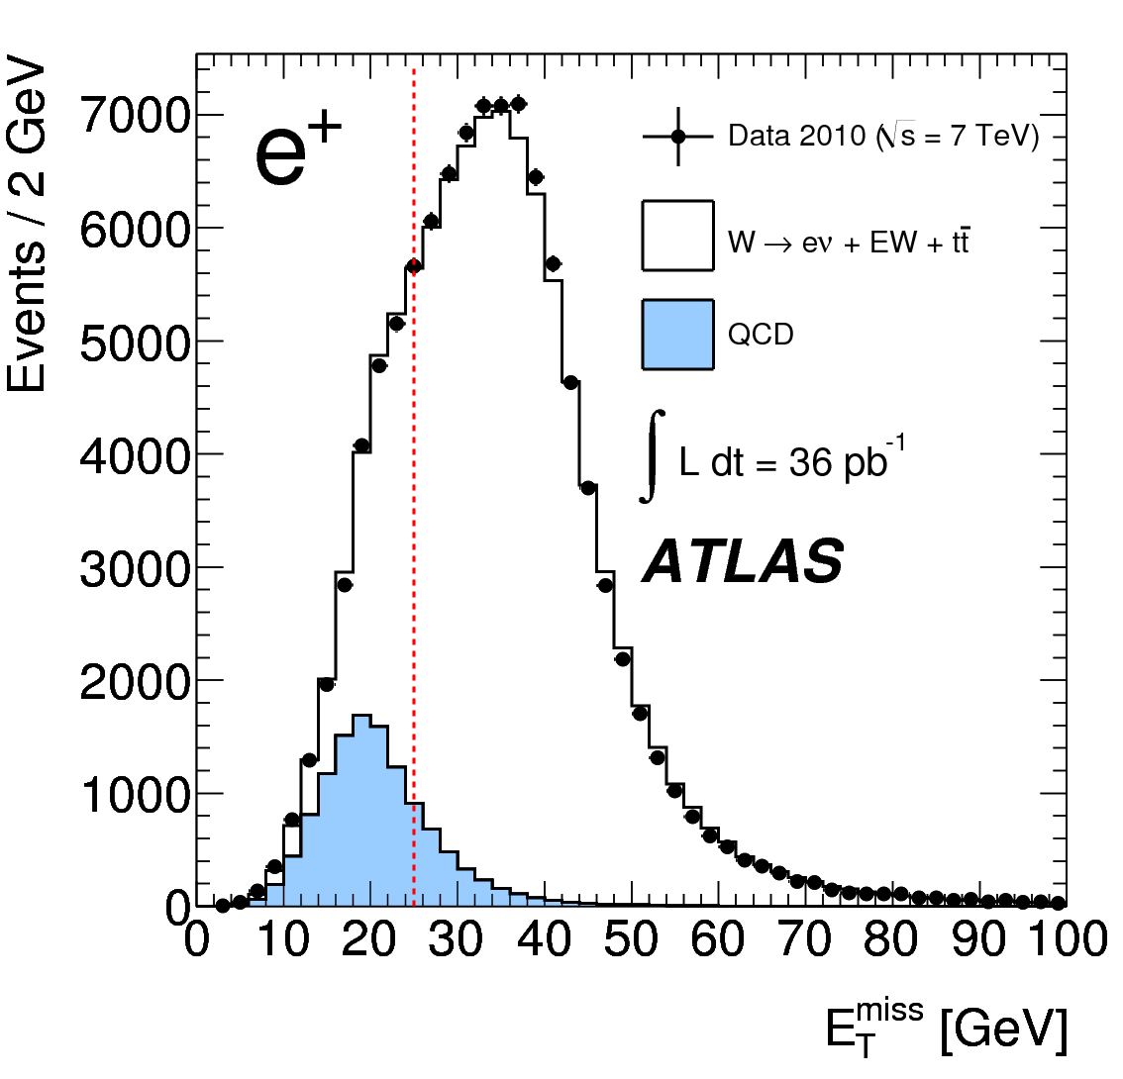
Backgrounds
MC are used for Electroweak backgrounds (top, W, Z, dibosons)
  ~3.5% for W (in both the muon and the electron channels)
  ~0.5% for Z (electrons and muons)
  Essentially the same level of electroweak background, regardless of the jet activity recoiling the vector bosons
  Special care brought to top in high jet multiplicity events
Dominant background: QCD multijets
  Fake electrons from single hadrons or conversions (dominant in electron channel)
  Heavy flavor decays (dominant in muon channel)
Data-driven approach adopted for QCD
  < 2% for Z (ee,μμ) with or without jets
  ~2.5% Wμν (+jets); ~4.5% for Weν but ~15% when jets are required

Slide 62
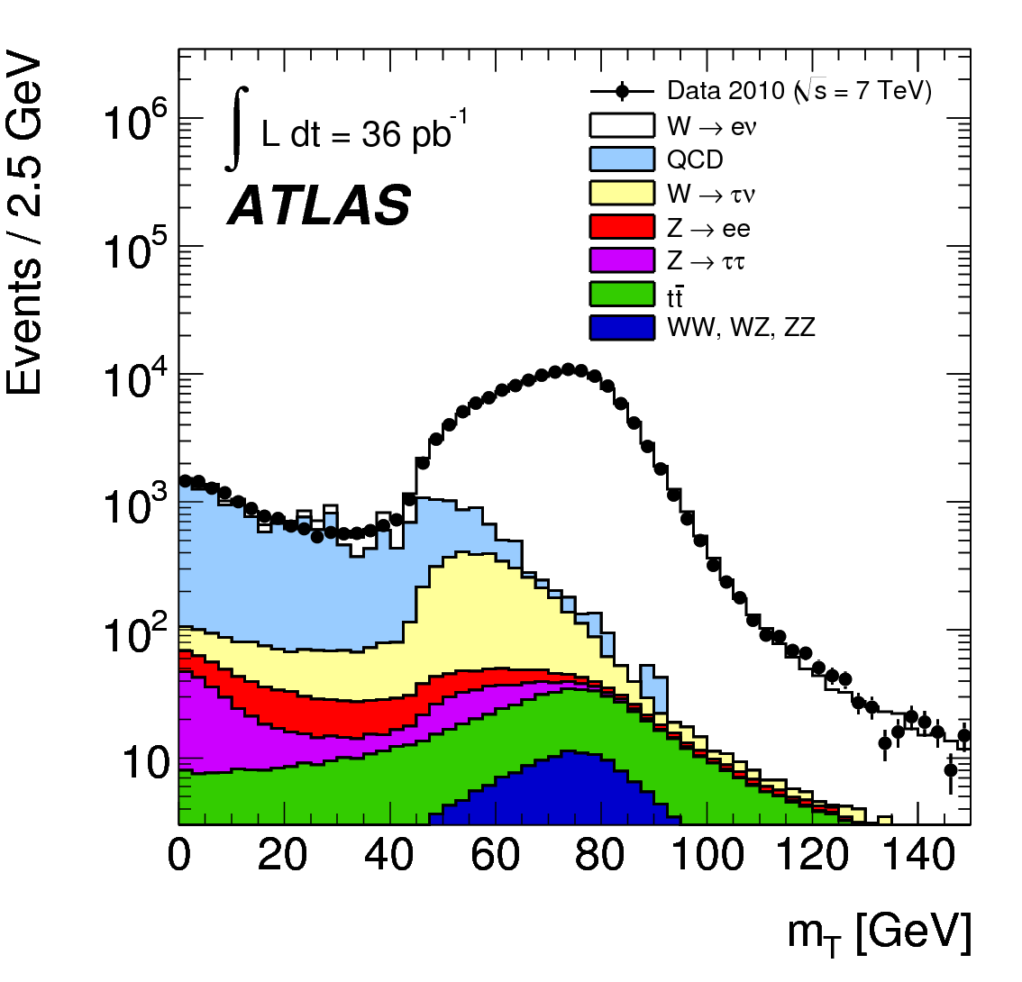
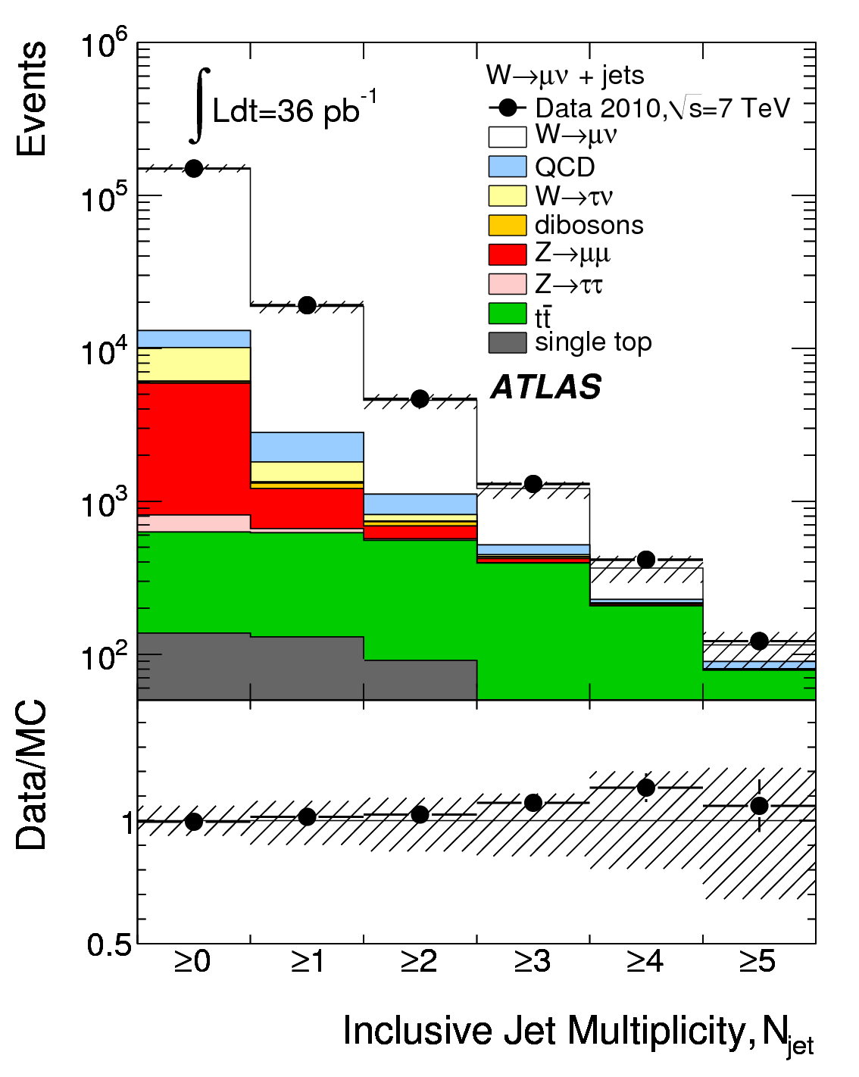
Data to MC comparisons
Transverse mass (M_{T}) in
Weν events
Jet multiplicity (N_{jet}) in
Wμν+jets events

Slide 63
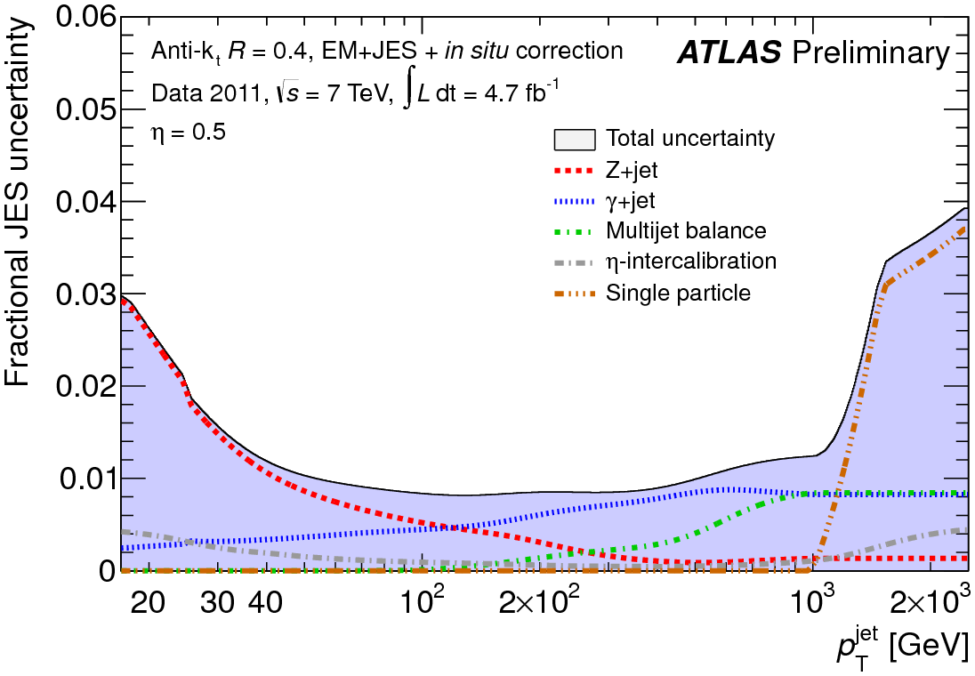
Jets in the measurements
Jets are reconstructed using the anti-kT algorithm with R = 0.4
  Infrared and collinear safe
  simple cone-like geometrical shape
  Used both on predictions and data
Calibration: numerical inversion method
  Dominant systematic in W/Z+jets
  Use in-situ studies to keep systematics low
    single hadron, γ+jets and Z+jets events
    2010 analysis used MC-based corrections
  JVF = Σ p_{T} (tracks) in a jet pointing towards the primary vertex / Σ p_{T} (tracks) in a jet
Selection | W+jets | Z+jets | Rjets | W/Z+b-jets
Jet p_{T} ≥ | 20 | 30 | 30 | 25
Jet |y| ≤ | 4.4 | 4.4 | 2.8 | 2.1
ΔR_{jet-lep} ≤ 0.5 | Jet ignored |  | Event rejected if ε [0.2,0.5] | As W+jets
JVF > 0.75 | Applied to all to reject fake pile-up jets

Slide 64
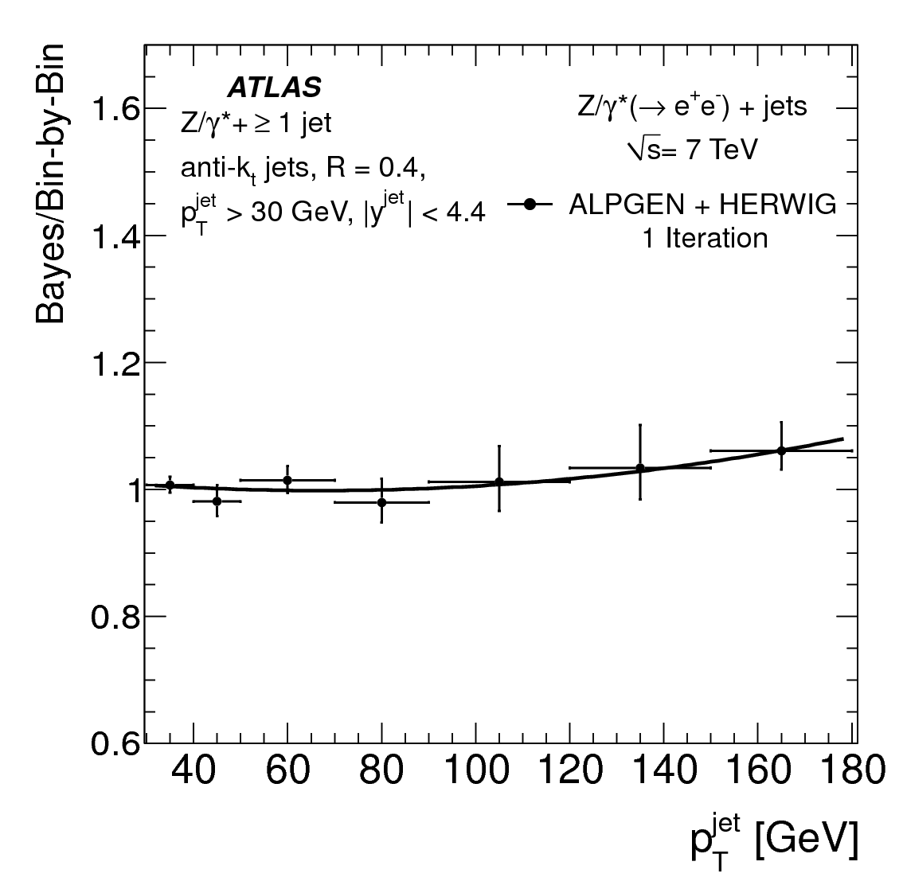
Unfolding
Measurement-theory comparison done at particle level:
  Raw observation corrected for detector effects
  Theory predictions corrected for hadronization, underlying events, etc.
➔Allow for direct comparison to calculation and tune the theory
➔Correct for flavor effects in calibration
Compare two different methods:
  Iterative Bayesian unfolding method
    Lower MC dependence and better stat. treatment
    Different number of iterations in different bins
  Bin-by-bin unfolding
    Simpler and better understood for ratios
Dependence on prior tested by comparing unfolding obtained from different generators (ALPGEN vs SHERPA).

Slide 65
W/Z+Heavy flavor (I)
Challenging: Small cross section but large background (especially W+b)
b-jets are identified by exploiting the long lifetime (1.5 ps) and large mass of B-hadrons
  b-tagging require a displaced secondary vertex in a jet with a decay length significance of > 5.85
    ~50% b-jet efficiency in a ttbar sample
    Efficiency from muon p_{T} relative to the jet axis
B-tagging affects sample composition

Slide 66
W/Z+Heavy flavor (II)
Fraction of W+b/c/l jets from a fit to the mass distribution of the secondary vertex
  Estimate template shapes from MC
  Systematic uncertainties on shapes by comparing data and MC in control regions
Cross section at event level
First measurement in exclusive jet bins
  Vetoed on number of jets (<3) to control top background
  Help to find “problems” in predictions
Inclusive b-jet cross section in association with a Z
Electron and muon channels are added to the same template to improve statistics

Slide 67
Some more results

Slide 68
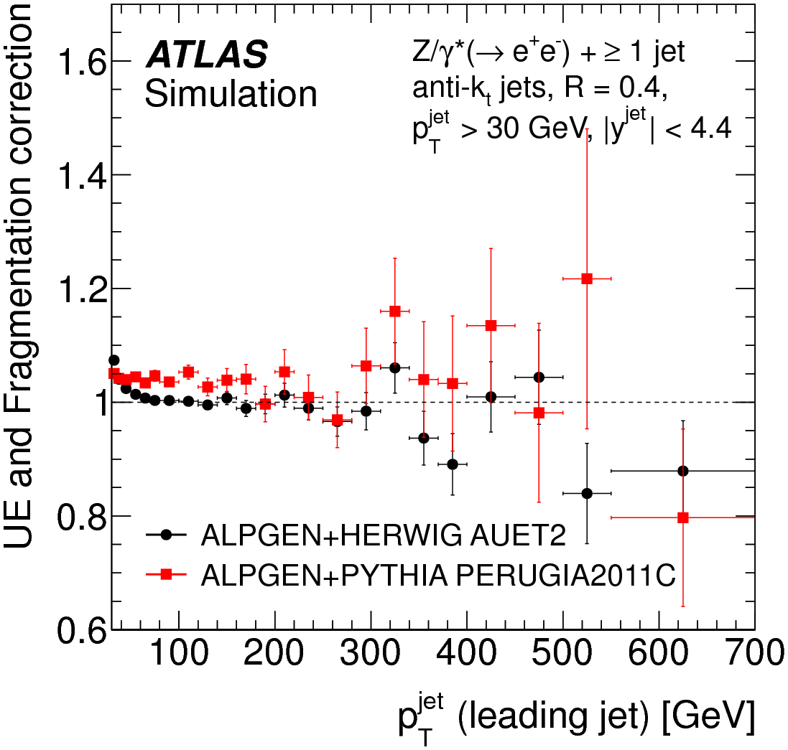
Other Z+jets results
Size of non-perturbative
corrections and uncertainties

Slide 69
Electroweak cross sections summary

Slide 70
Other new physics interpretations

Slide 71



LED: Model assumptions
Limits assume extra dimensions are flat and compactified on n-dimensional torus
  SM fields attached to a 3-brane
    Brane deformation ignored
  Continuous KK-spectrum is assumed, even for n=6
    Universal couplings of each modes
    Assumed the spectrum stops at M_{D}
Fundamental to effective scale relationship:
Prediction from minimal graviton emission model of GRW
  Valid: E<<M_{D}; Pert. exp. break: E > 7 M_{D}

Slide 72


LED: Experimental signatures
Direct graviton production in association with partons or photons
Graviton interaction with
detector suppressed by M_{Pl}⁻²
➔ Missing transverse energy
Signature at the LHC
  Monojet
    More jets due to QCD radiation
  Monophoton

Slide 73


LED: Limits
Typical efficiency for jets and Met selection: ~83%
  Similar for Zvv, and ADD and general dark matter model
Set 95% C.L. limits on M_{D}
  Truncation: quantify UV effects not modeled by L_{eff}
    Δσ/σ = 0% (n=2), 6% (n=3), 20% (n=4), 45% (n=5), 60% (n=6)
  ➔ model does not make non-ambiguous predictions with SR4
    Limits of SR1 to SR3 are 35%, 15%, 5% worse, but less UV sensitive

