Slide 1
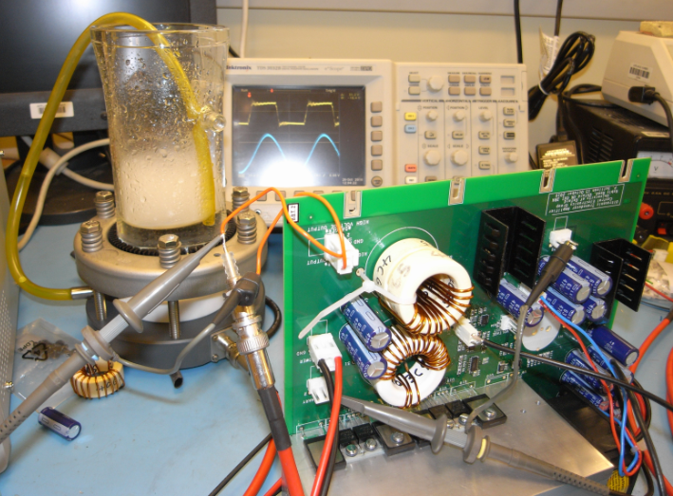
Physics Electronics Group
PP sub-department meeting
5 October 2011

Slide 2
The group
CEG Engineers: Main task:
Adam Baird Astrophysics: SKA
Mike Dawson Particle Physics - MICE
Johan Fopma Head of CEG
Rui Gao Particle Physics - LHCb
David Howell Laser safety, Astrophysics
Jaya John John Particle Physics - PimMS
Mark Jones Head of CEG workshop, Particle Physics
Hamid Khah Central – Astro, Atomic & Laser, CMP
Roy Wastie Particle Physics - SLHC
CEG Technicians
Joe Brown
Bryan Finegan
Keiran Foster
Peter Hastings
Greg King
Kahinde Johnson
Rik Elliott
PAT testers
Roy Jelfs (Clarendon, Atmos)
Nik Windle (DWB, Theory)

Slide 5
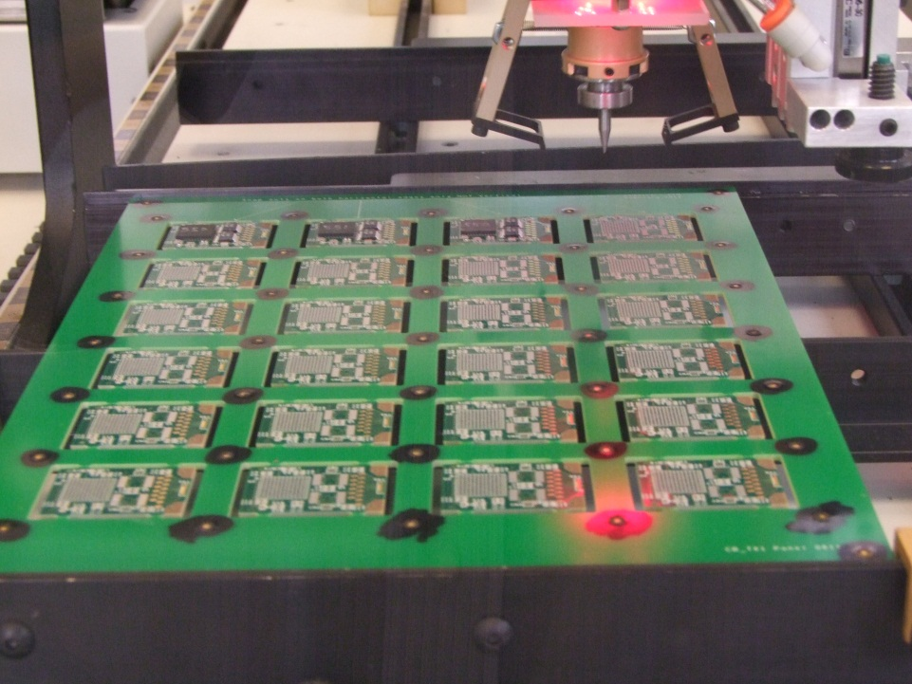
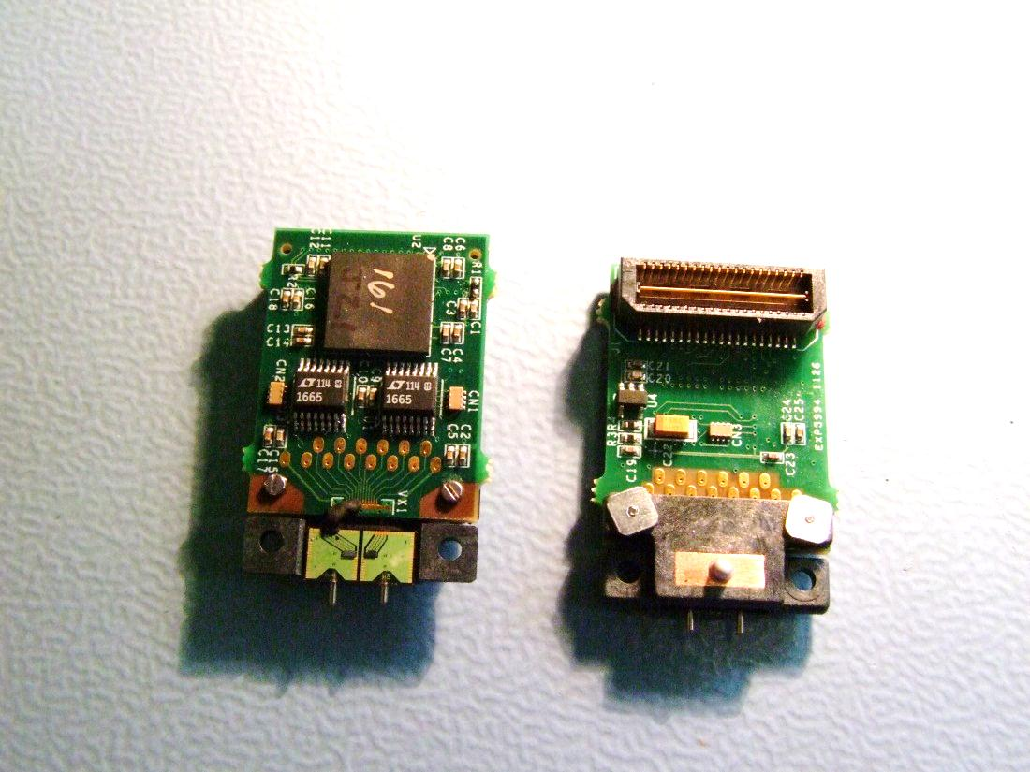
ATLAS
Bi-Phase-Mark ASIC’s test bench
We are assembling and testing ~1000 boards

Slide 6
SLHC
Stave R&D & production
Tapes R&D & production
Optical Fibres R&D & production préparation
Building 180

Slide 7
LHCb Upgrade Front-end board for 64 channel MCP detectors

Slide 8
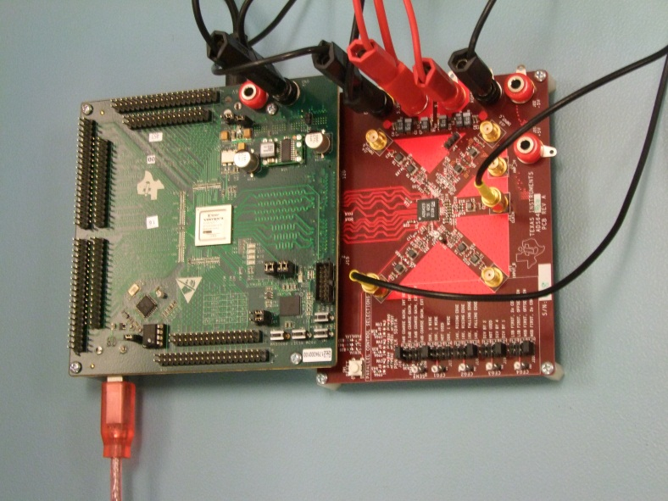
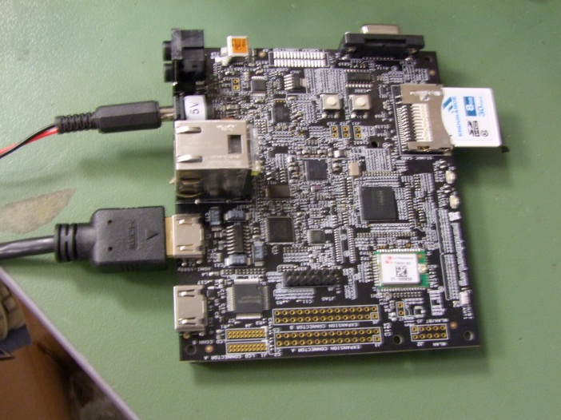
Impact projects:
MARS
(Multi ADC/TDC readout for Neutron detectors readout) (MPPC’s)
Hive
Low power computing

Slide 9
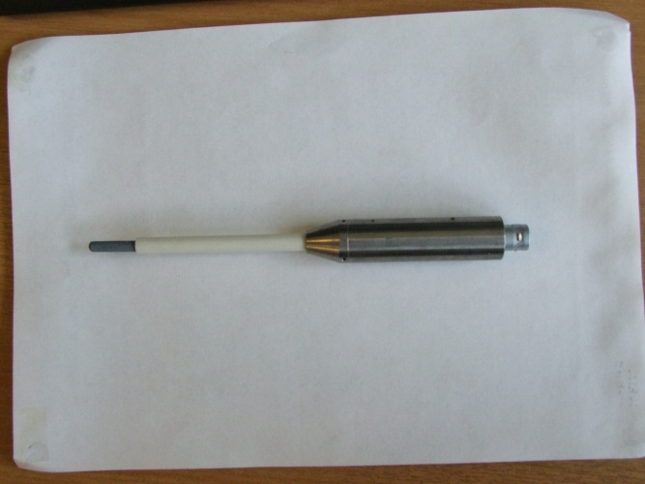
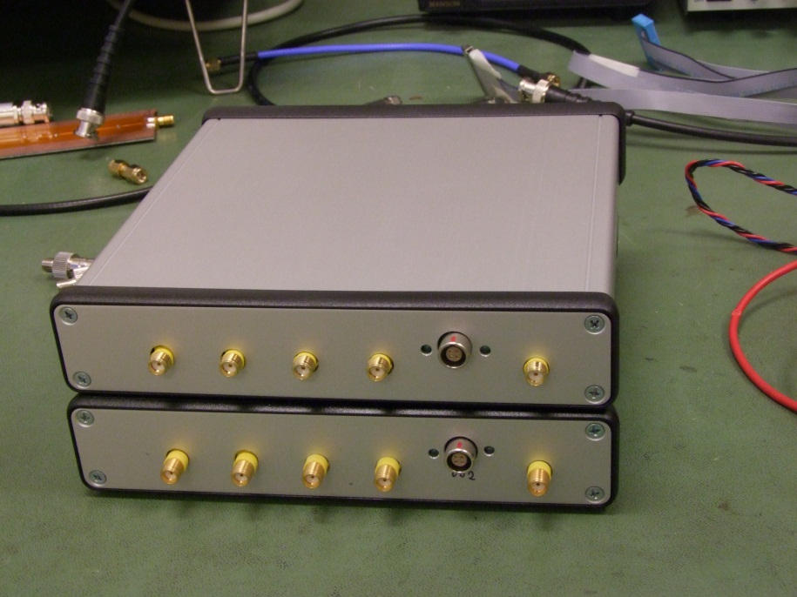
BDOT probe probes magnetic fields in laser fusion facility (A&L).
Very fast update 8 Channel DAC (200 MSPS)

Slide 10
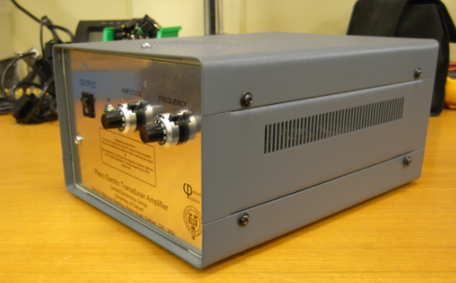
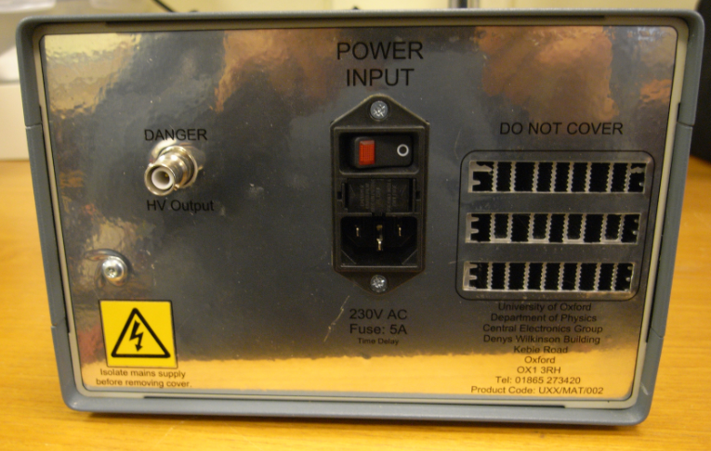
For the Department of Materials :
Equipment design and build:
Nebuliser Unit

Slide 11
Some of our Challenges
Assembly of some components very challenging: 1136 pin BGA’s. Leaded solder preferred.
Programming National Instruments’ CompactRio.
Running LabVIEW in an FPGA.
Safety critical programming.
GBps Ethernet/USB2 interfacing.
Designing boards at >5GHz.
Firmware designs at the limit of technology

Slide 12
Cost recovery
Monthly sheets for on-going work
Fixed price jobs committed beforehand similar to RTO. Order form to be held by Service. Physics Finance and service manage the same spreadsheet to determine status.

