Slide 1
How do you drive the world’s biggest machine?
www.physics.ox.ac.uk/accelerate

Slide 2
Before we start
Please don’t touch the equipment
In case of fire…
High voltages
Please don’t volunteer if you have a pacemaker or are pregnant
Please switch off all mobile phones
Notes:
You should update this with any safety considerations specific to your venue or version of the show.
http://www.physics.ox.ac.uk/accelerate/resources/safety

Slide 4
Recipe for a particle accelerator
Particles
Energy
Control
Collision
Detection
Notes:
This is the first time we encounter the recipe for a particle accelerator
http://www.physics.ox.ac.uk/accelerate/resources/the-recipe

Slide 5
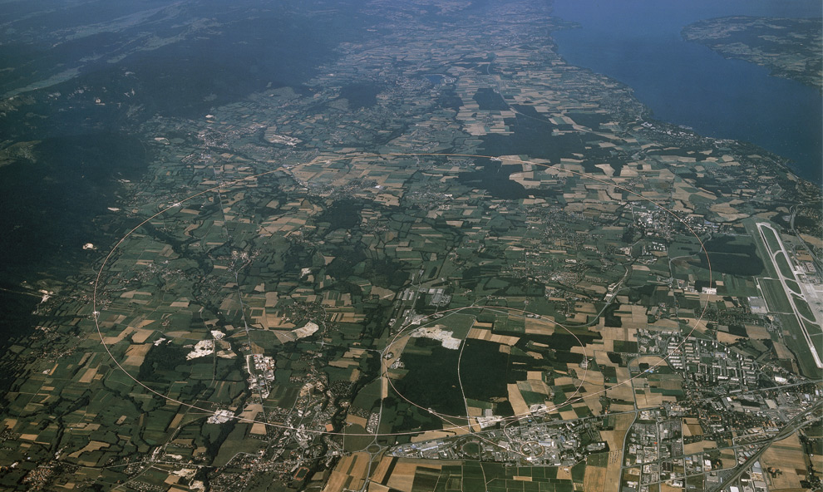
Large Hadron Collider
Notes:
This is an image of the LHC from the air. The blue line emphasises the path of the accelerator tunnel, which is slightly hard to see otherwise.

Slide 6
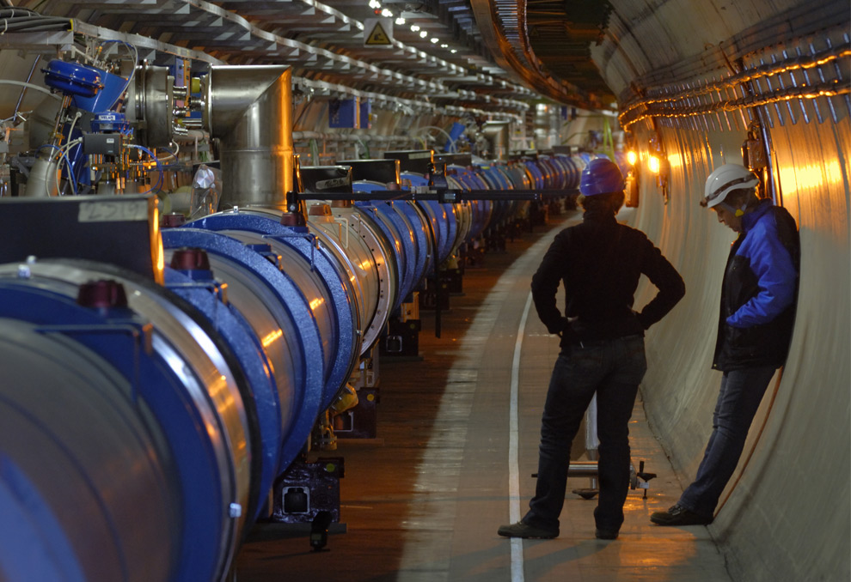
Large Hadron Collider
Notes:
This is a typical section of the underground tunnel. The accelerator is such a huge circle that, underground, it almost looks straight.

Slide 7
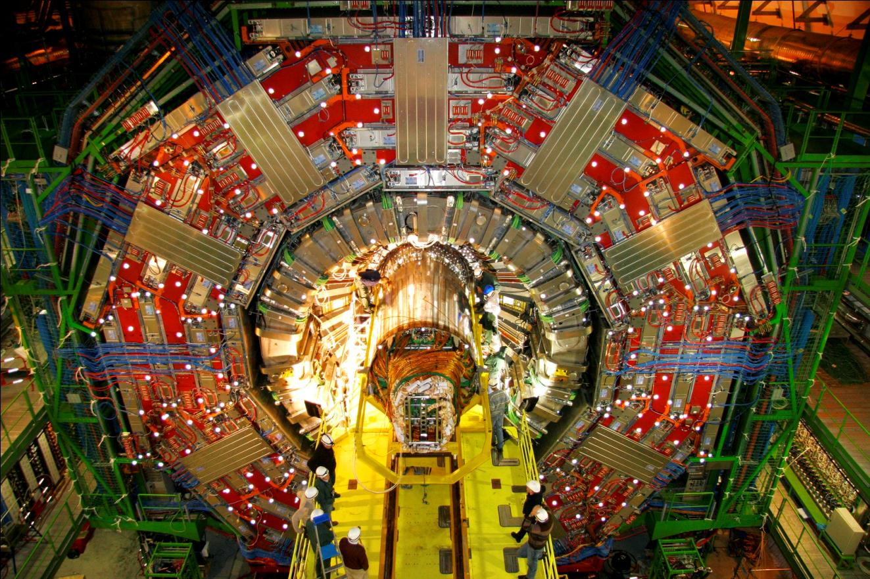
Large Hadron Collider
Notes:
This is the CMS detector, one of the general-purpose detectors at the LHC.

Slide 9
Recipe for a particle accelerator
Particles
Energy
Control
Collision
Detection

Slide 11
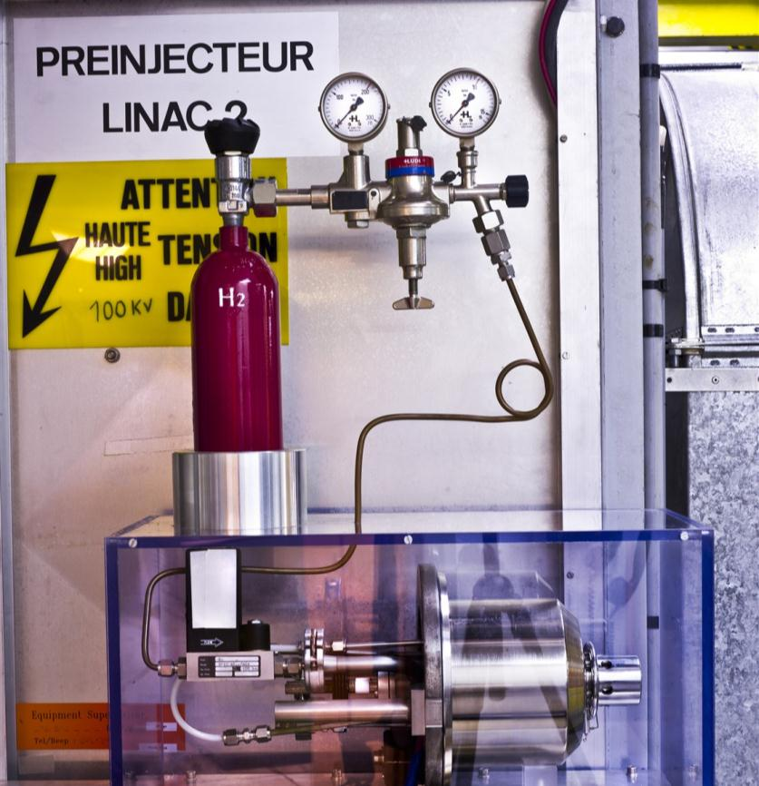
LHC injector
Notes:
This bottle of hydrogen supplies all the protons used in the LHC.

Slide 12
Recipe for a particle accelerator
Particles
Energy
Control
Collision
Detection

Slide 14
Human scale
1 m
Notes:
These silhouettes represent human-scale objects being seen by reflected light. They’re actually Andrew Steele and Suzie Sheehy!

Slide 15
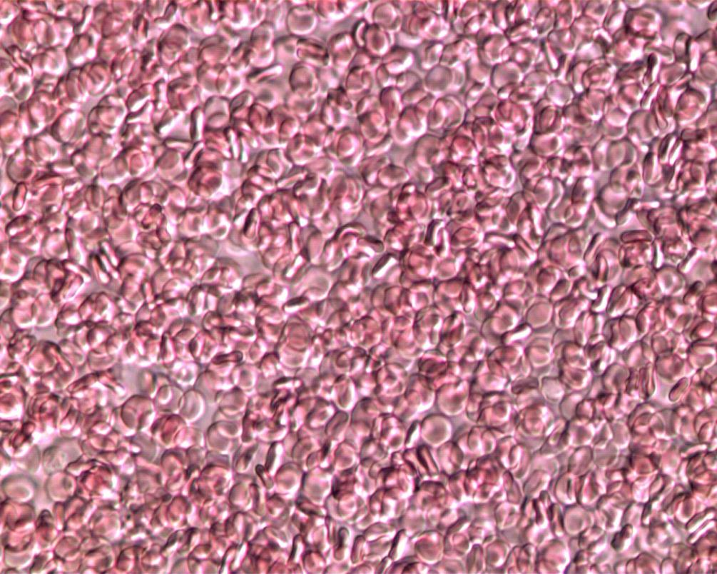
Optical microscope up to 1000×
Notes:
This is some human blood photographed with a light microscope on the Oxford University biophysics practical course. It’s Andrew Steele’s!

Slide 16
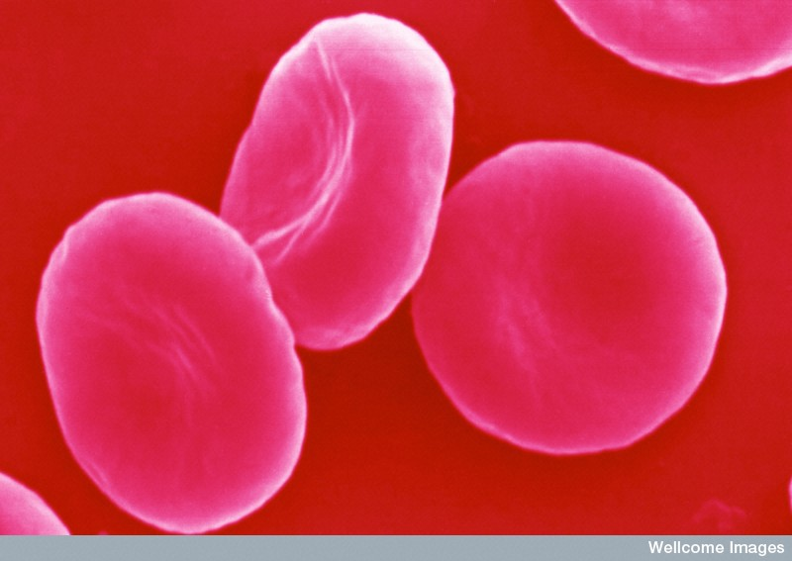
Electron microscope up to 500,000×
Notes:
This is an SEM image of some red blood cells, courtesy of the Wellcome image library. The redness is added in post-production: electrons don’t see colour!

Slide 17
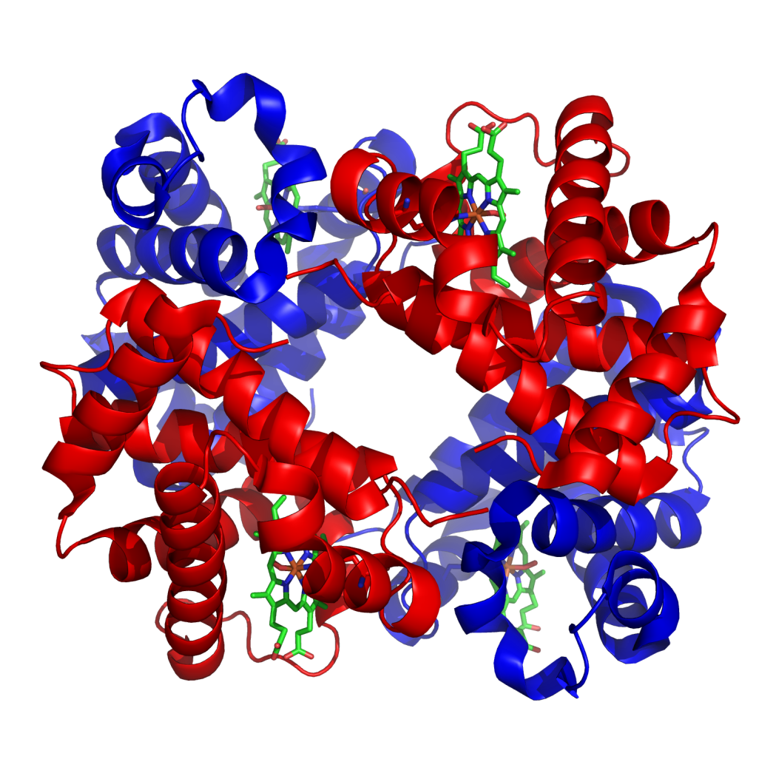
Particle accelerator up to 10,000,000×
Notes:
This is a representation of a haemoglobin molecule, which is used to carry oxygen in blood.

Slide 18
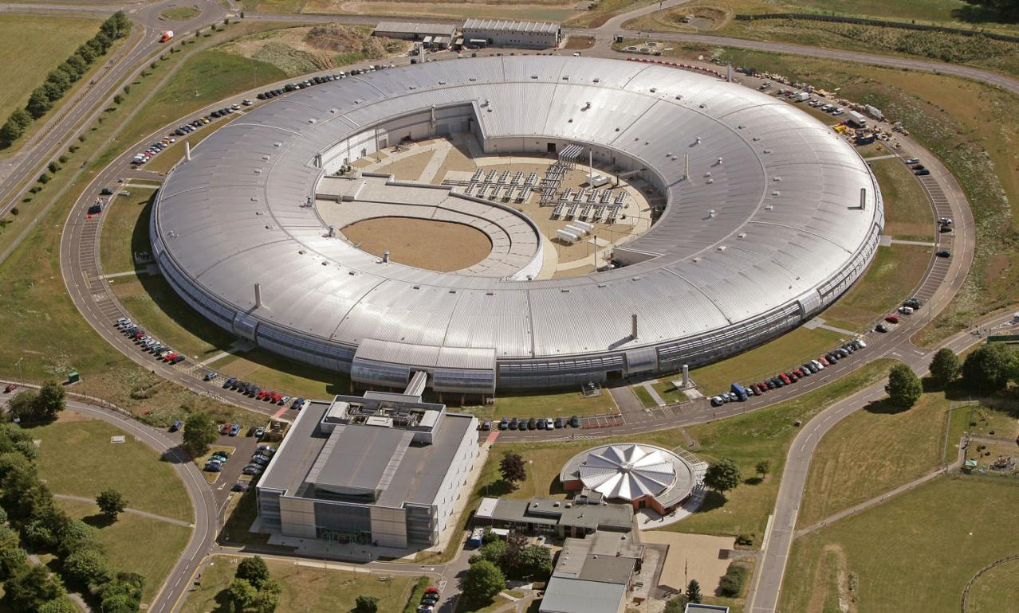
Diamond Light Source
Notes:
This is an aerial view of the Diamond Light Source.
http://diamond.ac.uk/

Slide 20
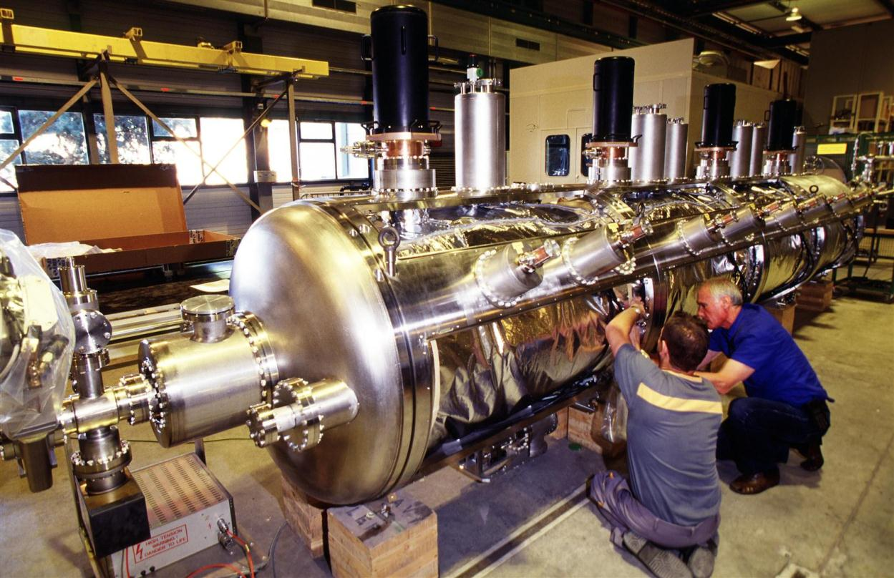
LHC RF cavity
Notes:
RF cavities like this one are used to accelerate the protons in the LHC.

Slide 21
Recipe for a particle accelerator
Particles
Energy
Control
Collision
Detection

Slide 23
Recipe for a particle accelerator
Particles
Energy
Control
Collision
Detection

Slide 25
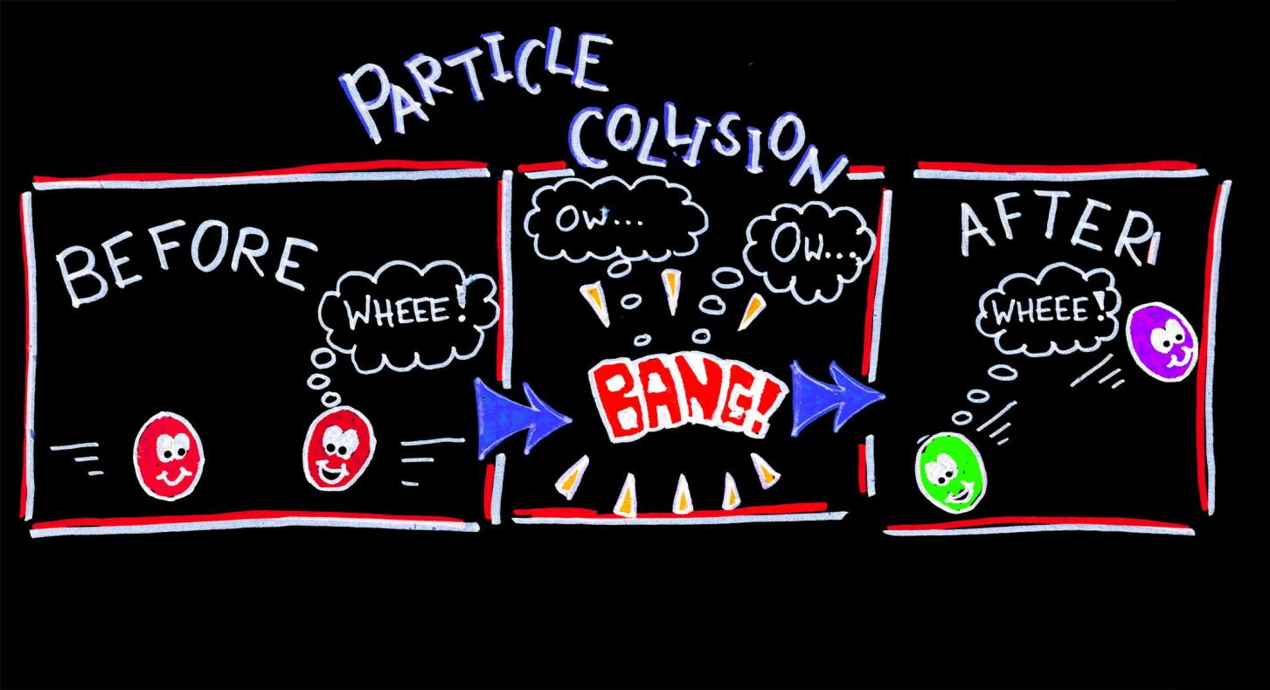
Notes:
This cartoon shows two protons slamming together, and two entirely different particles coming out. It’s usually a lot messier than this…for a start it’s the quarks rather than entire protons which collide!

Slide 26
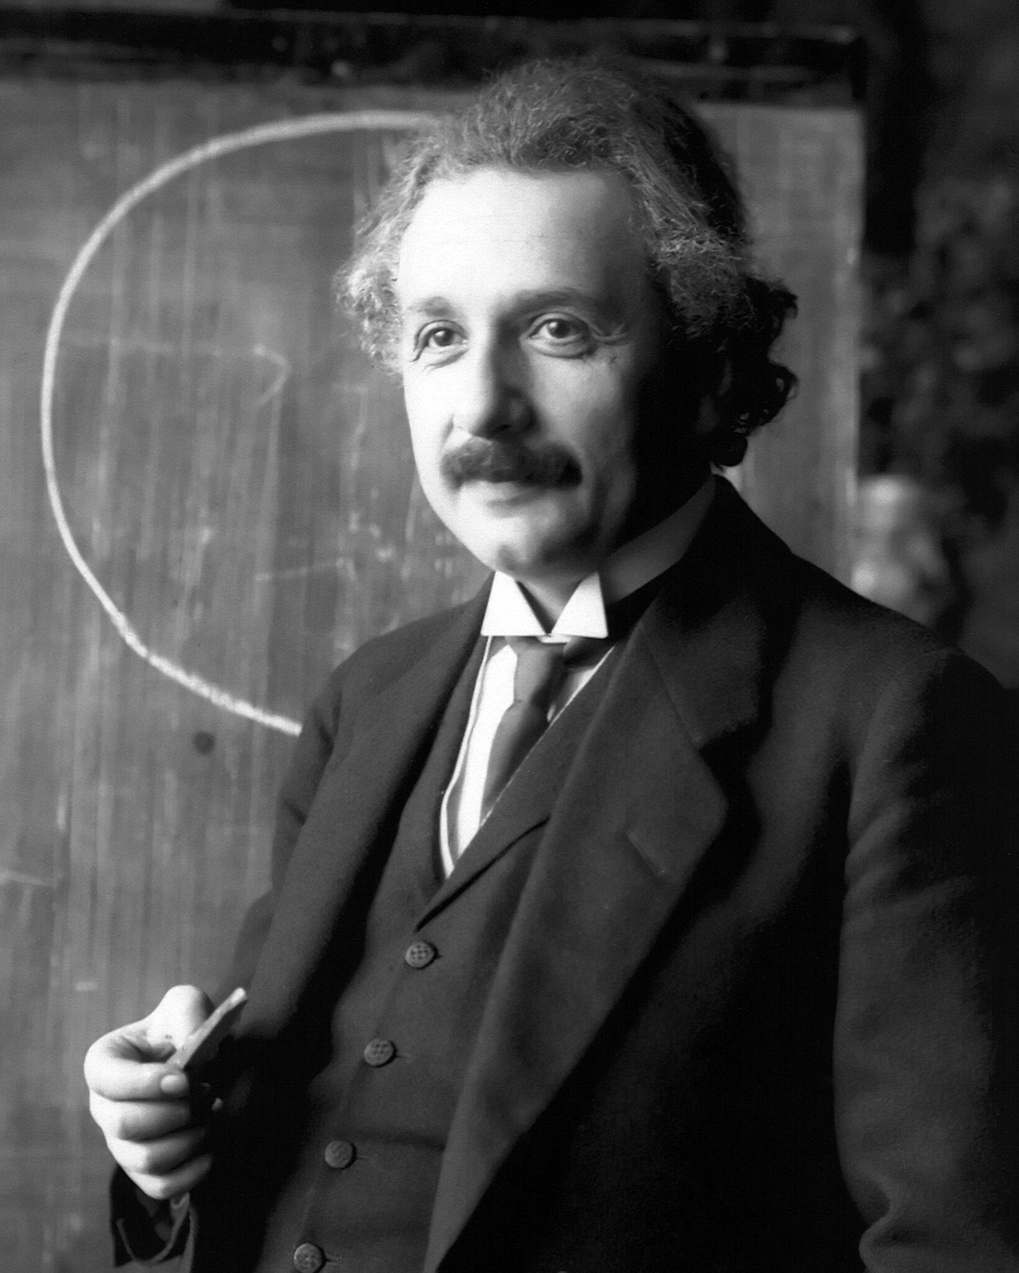
E = mc²
Notes:
E = energy
m = mass
c = the speed of light, 299,792,458 m/s

Slide 28
Recipe for a particle accelerator
Particles
Energy
Control
Collision
Detection

Slide 30
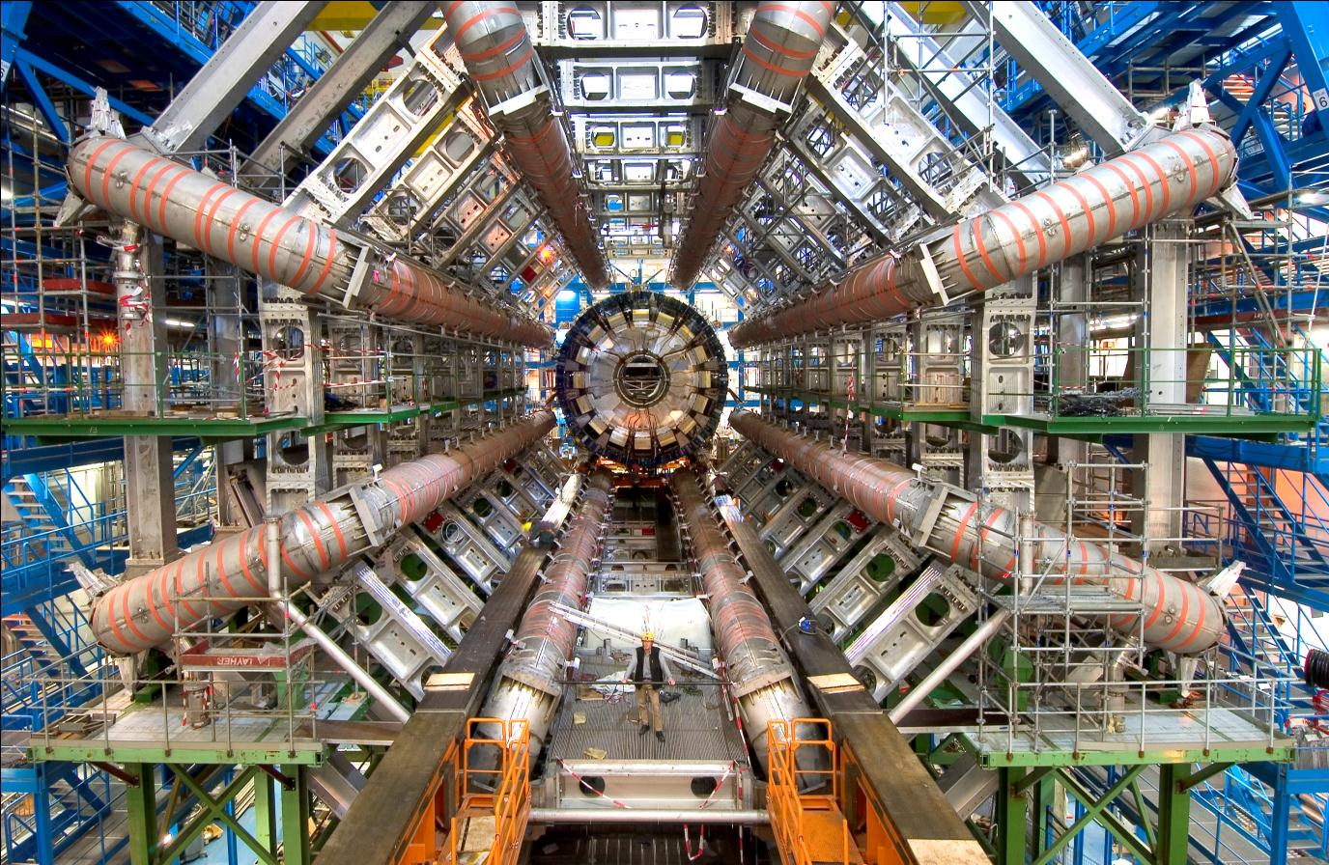
ATLAS detector
Notes:
This is the ATLAS cavern before all the detector electronics were placed inside. The hard-hatted guy stood in the middle gives a sense of scale. The orange-striped tubes are electromagnets which bend the paths of the particles spraying out from a collision.

Slide 31
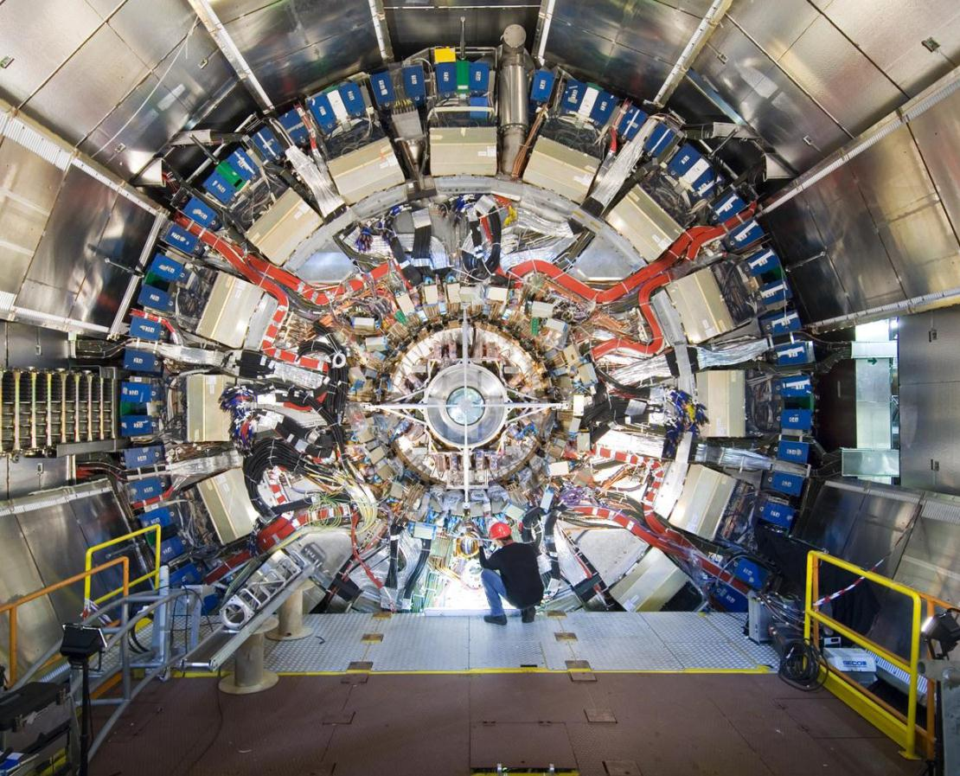
ATLAS detector
Notes:
This is the ATLAS detector endcap, behind which is the mass of electronics which was inserted.

Slide 32
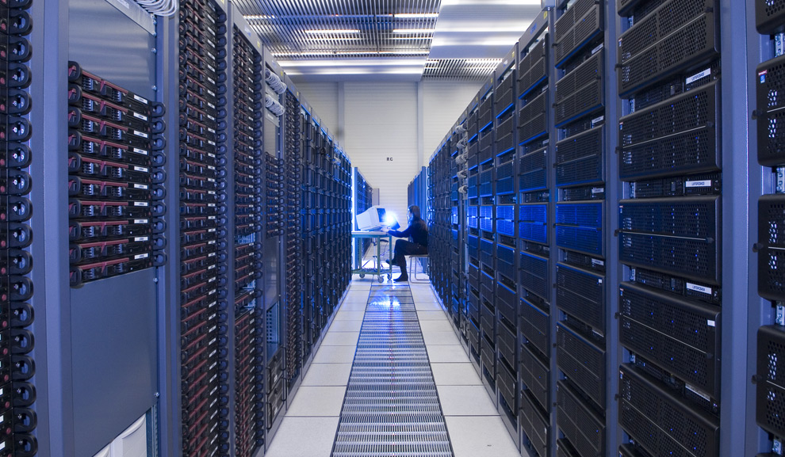
LHC computers
Notes:
This is one of the aisles of servers at the LHC, used to store and process the data collected, and share it worldwide on the Grid.

Slide 33
Recipe for a particle accelerator
Particles
Energy
Control
Collision
Detection

Slide 34
Large Hadron Collider: CMS
Notes:
This is the image from earlier of the CMS detector—one of the general-purpose detectors, along with ATLAS.

Slide 35
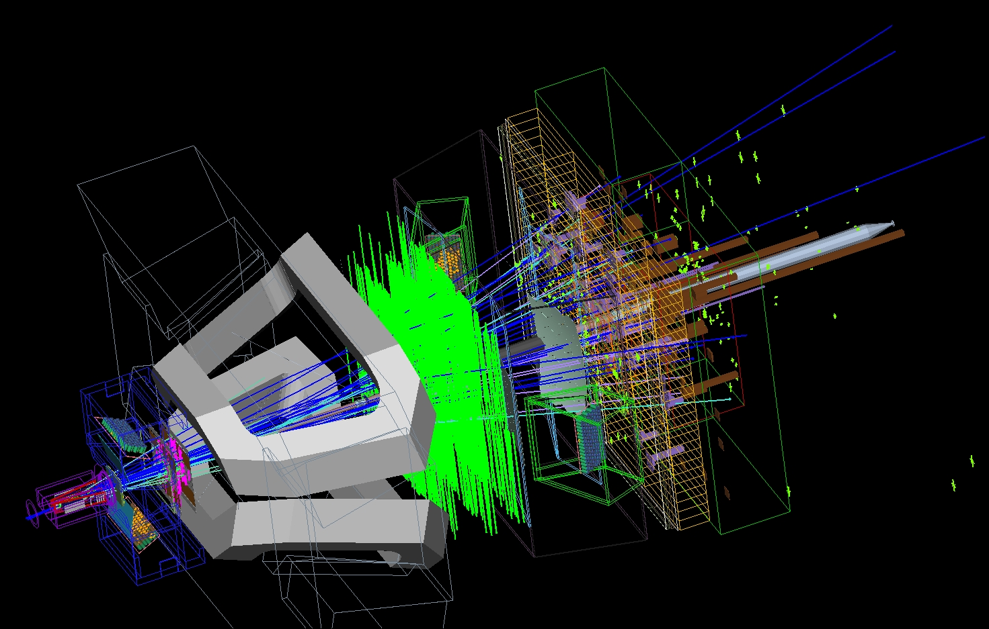
Large Hadron Collider: LHCb
Notes:
This is a simulation of an event from LHCb, which is trying to account for the asymmetry between matter and antimatter.

Slide 37
LHC images © CERN
Blood SEM image © David Gregory & Debbie Marshall, Wellcome Images
Haemoglobin molecule image CC BY-SA Richard Wheeler
Accelerate! is released under a Creative Commons
Attribution–Non-Commercial–Share-Alike License
Developed at the University of Oxford supported by STFC and SEPnet
www.physics.ox.ac.uk/accelerate

